Slide 1

Statistical modelling
NST Part II BBS Bioinformatics 2024-25
Dr. Vicki Hodgson

Slide 2
Linear models
Statistical inference
Hypothesis testing
Modelling data
Extending the linear model

Slide 3
1. Statistical inference
Drawing conclusions about a population based on a sample

Slide 4

Populations & samples of stuff
Population
The complete set of stuff I want to know something about

Slide 5

Populations & samples of stuff
Inference
Population
The complete set of stuff I want to know something about
Sample
The (much smaller) set of stuff I can actually see
Notes:
Measure some information about our sample
And use this to make some inference about what’s going on in the entire population
This is a very abstract & difficult idea right now, so we need some framework for making this inference

Slide 6

Statistical inference: simplifying framework
Notes:
Statistics are that framework

Slide 7
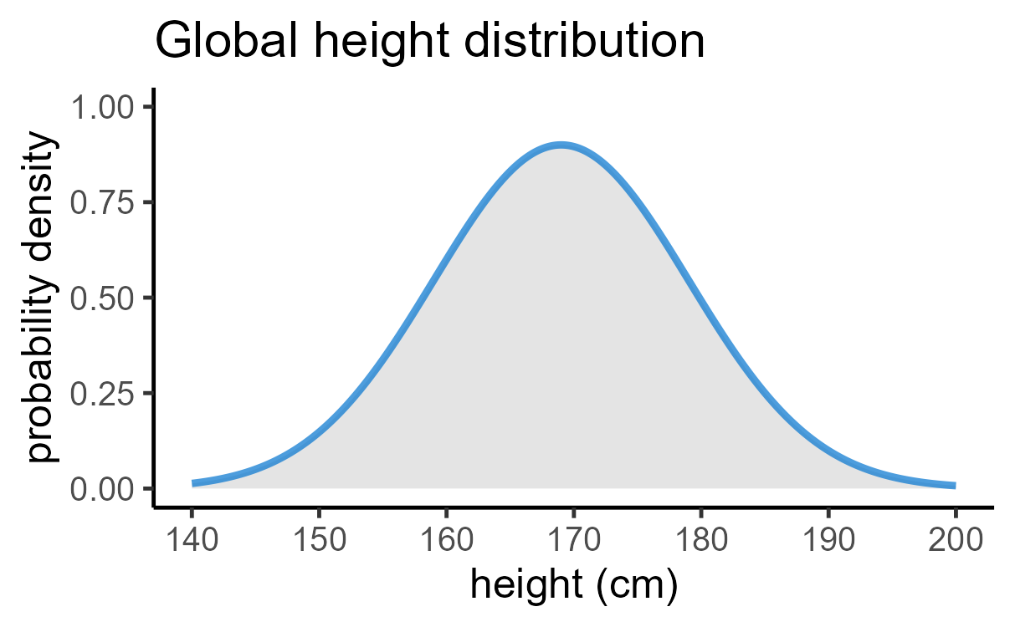
Statistical inference: simplifying framework
Abstraction
Notes:
Instead of thinking about an entire globe of humans, we can abstract away to a nice simple 2D graph

Slide 8
Statistical inference: simplifying framework
Abstraction
Distribution = function that shows:
The possible values a variable can take (x axis)
And the likelihood of those values occurring (y axis)
Notes:
This graph is a distribution function, specifically for the human height variable
It tells us everything we need to know about the variable

Slide 9

Statistical inference: simplifying framework
Abstraction

Slide 10
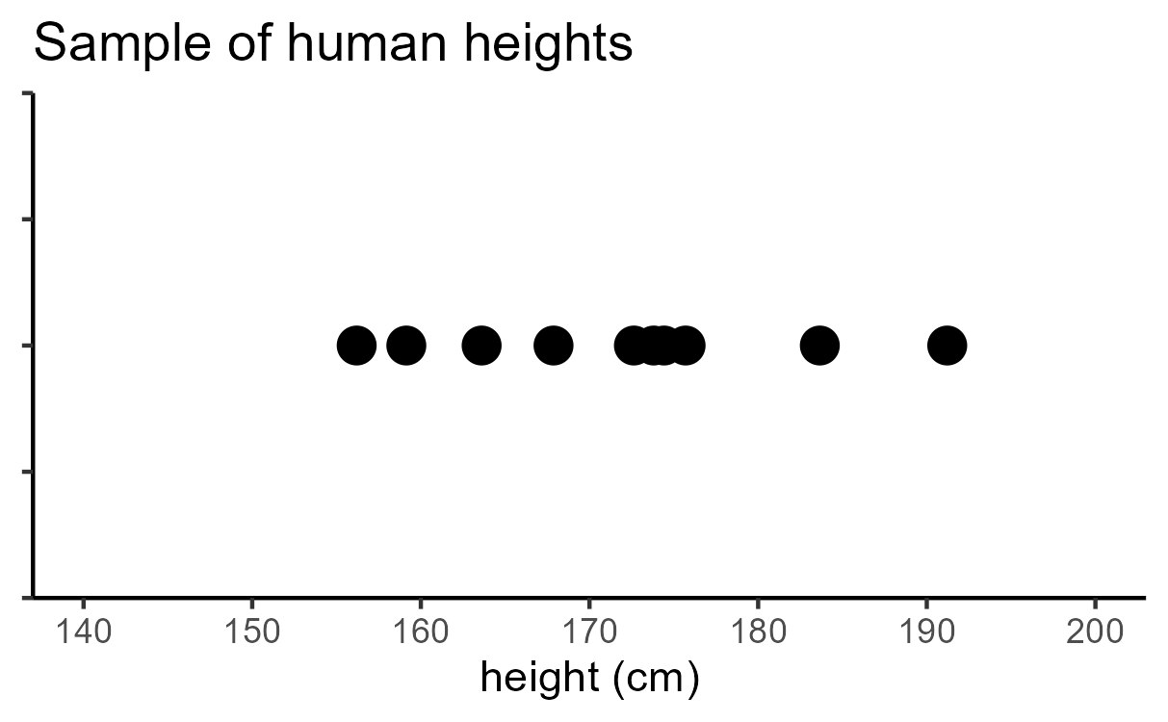
Statistical inference: simplifying framework
Abstraction
Abstraction
Notes:
We also abstract away from thinking about a room full of people, to a set of data points
Each dot representing a different person’s height
And the idea is that this sample has been drawn from this distribution
The distribution is the set of possible heights
From which we’ve pulled these 10 example heights
So the sample belongs to, or comes from, that population distribution

Slide 11
Statistical inference: simplifying framework
Abstraction
Inference
Abstraction
Notes:
Now, instead of making inferences from a room of people to an entire globe…

Slide 12
Statistical inference: simplifying framework
Abstraction
Inference
Inference
Abstraction
Notes:
… we make inferences from the sample, to the distribution that we drew that sample from

Slide 13
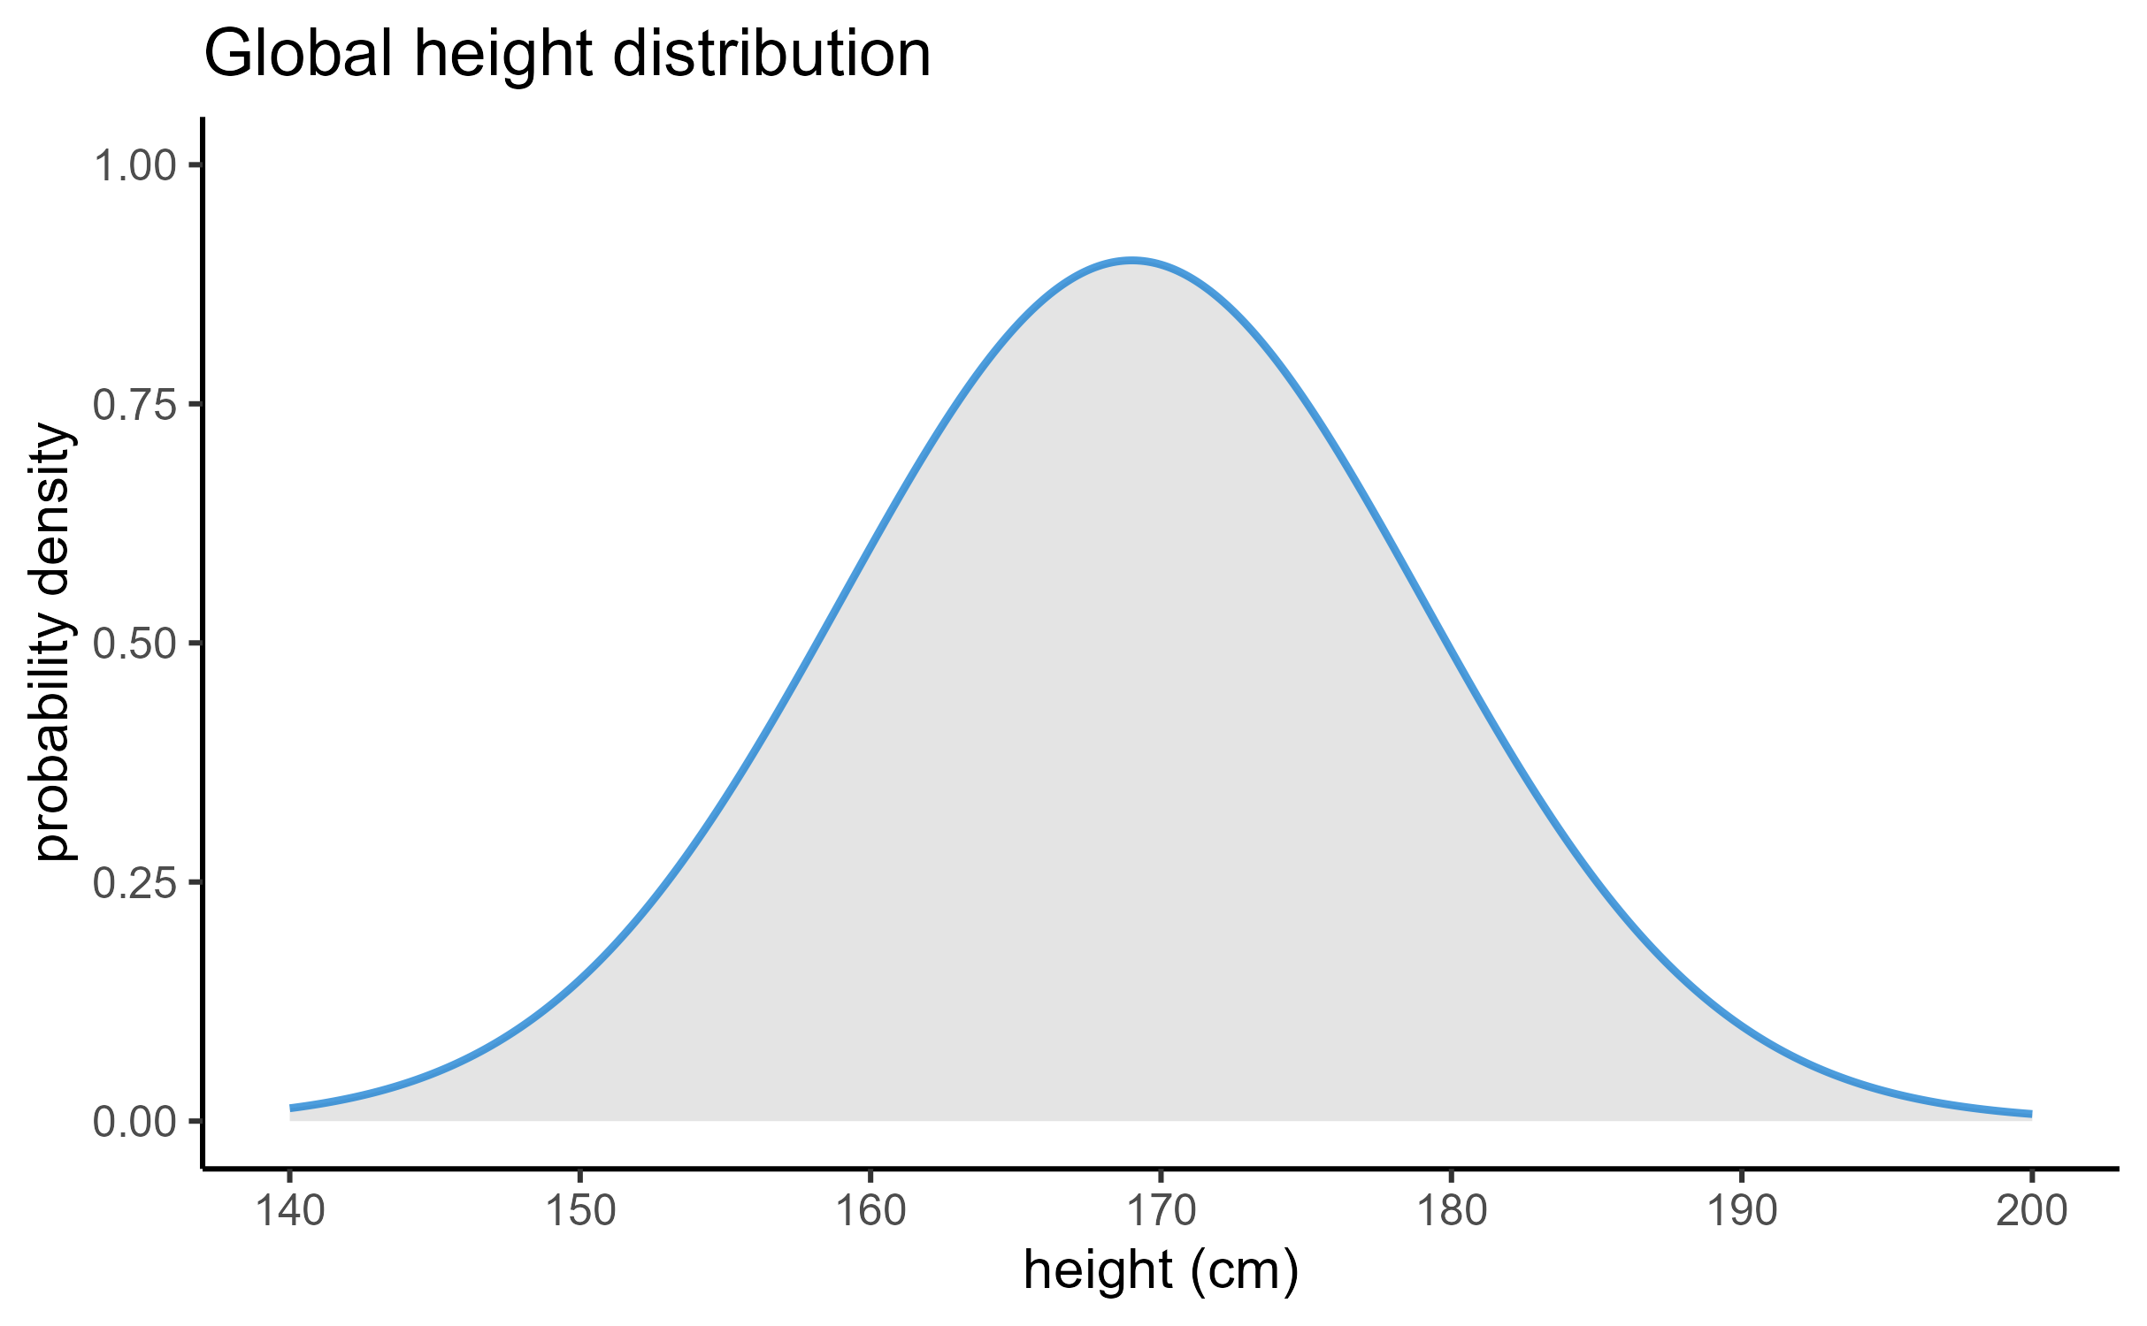
Distributions
Inference means two things:
Estimating parameters
Testing hypotheses

Slide 14
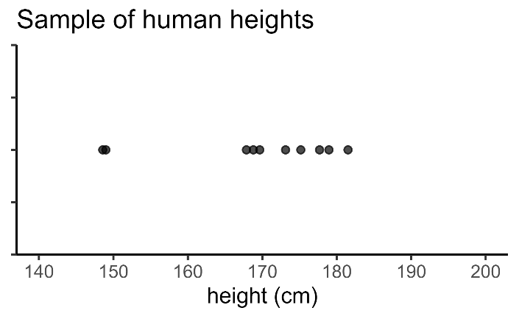
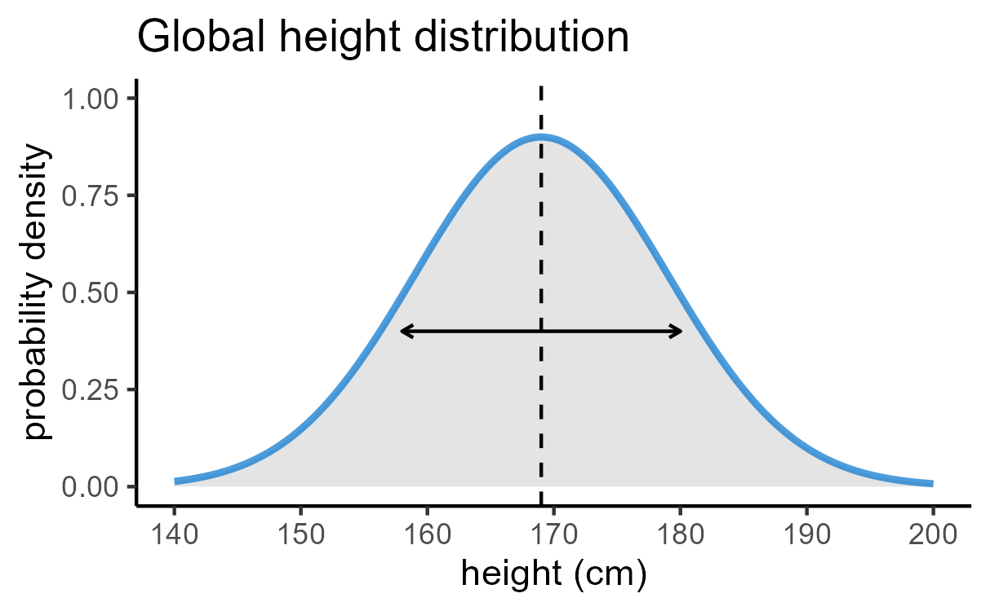
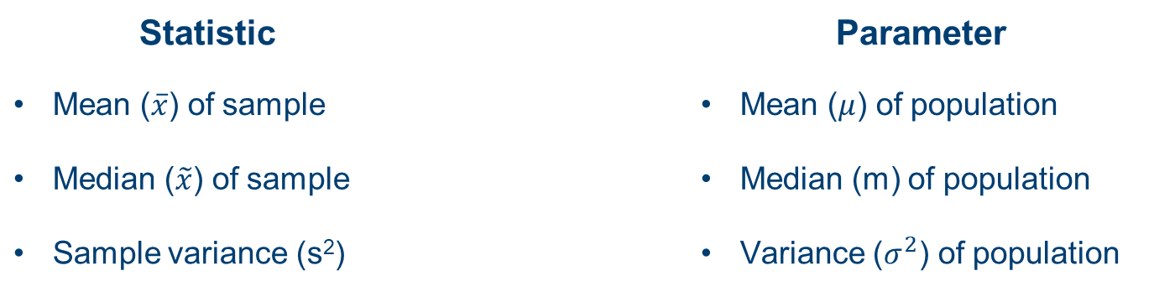
Parameters vs statistics
Statistic |  | Parameter
Mean ($\overline{x}$) of sample |  | Mean ($μ$) of population
Median ($\tilde{x}$) of sample |  | Median (m) of population
Sample variance (s²) |  | Variance ($σ^{2}$) of population
Inference

Slide 15
2. Null hypothesis significance testing
Statistics and p-values

Slide 16
Classical hypothesis testing

Slide 17
Classical hypothesis testing
Null hypothesis (H₀)

Slide 18
Classical hypothesis testing
Null hypothesis (H₀)
1. Choose test & calculate a test statistic
Formula that uses the dataset to create a single number
This number is the statistic
e.g., t-statistic, F-statistic

Slide 19
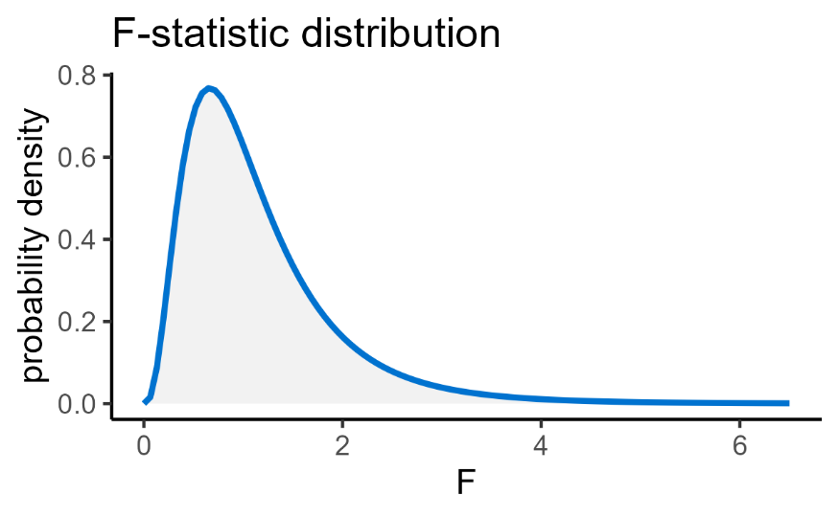
Classical hypothesis testing
Null hypothesis (H₀)
2. Assess probability of test statistic
Using the distribution of the statistic
Calculates a p-value

Slide 20
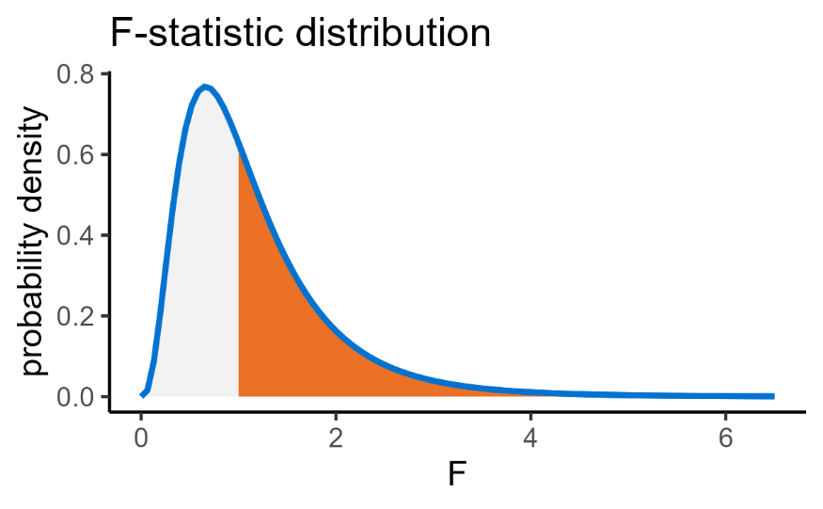
Classical hypothesis testing
Null hypothesis (H₀)
2. Assess probability of test statistic
Using the distribution of the statistic
Calculates a p-value

Slide 21

Classical hypothesis testing
Null hypothesis (H₀)
2. Assess probability of test statistic
Using the distribution of the statistic
Calculates a p-value

Slide 22
Classical hypothesis testing
Null hypothesis (H₀)
3. Reject or retain null hypothesis
Based on the size of the p-value

Slide 23
Classical hypothesis testing
Null hypothesis (H₀)
1. Choose test & calculate a test statistic
2. Assess probability of test statistic
3. Reject or retain null hypothesis

Slide 24
Interpreting results and p-values
p-value = probability of observing the data, if the null hypothesis is true
Property of the dataset
Not equal to the probability of the null hypothesis being true
Cannot provide “proof”
This means that all statistical tests are probabilistic and can be wrong!
Notes:
Probability of observing these data (this test statistic) or more extreme, if the null is true
Property of the dataset
If you ran the experiment again, the p-value would not be identical
Not equal to probability of null
It’s about the data, not the hypothesis
Cannot provide proof
P-value is evidence, but can never prove anything
Because it is probabilistic
More on the ways that it can be wrong in CS6

Slide 25
3. Modelling data
Partitioning variation into “signal” vs “noise”

Slide 26
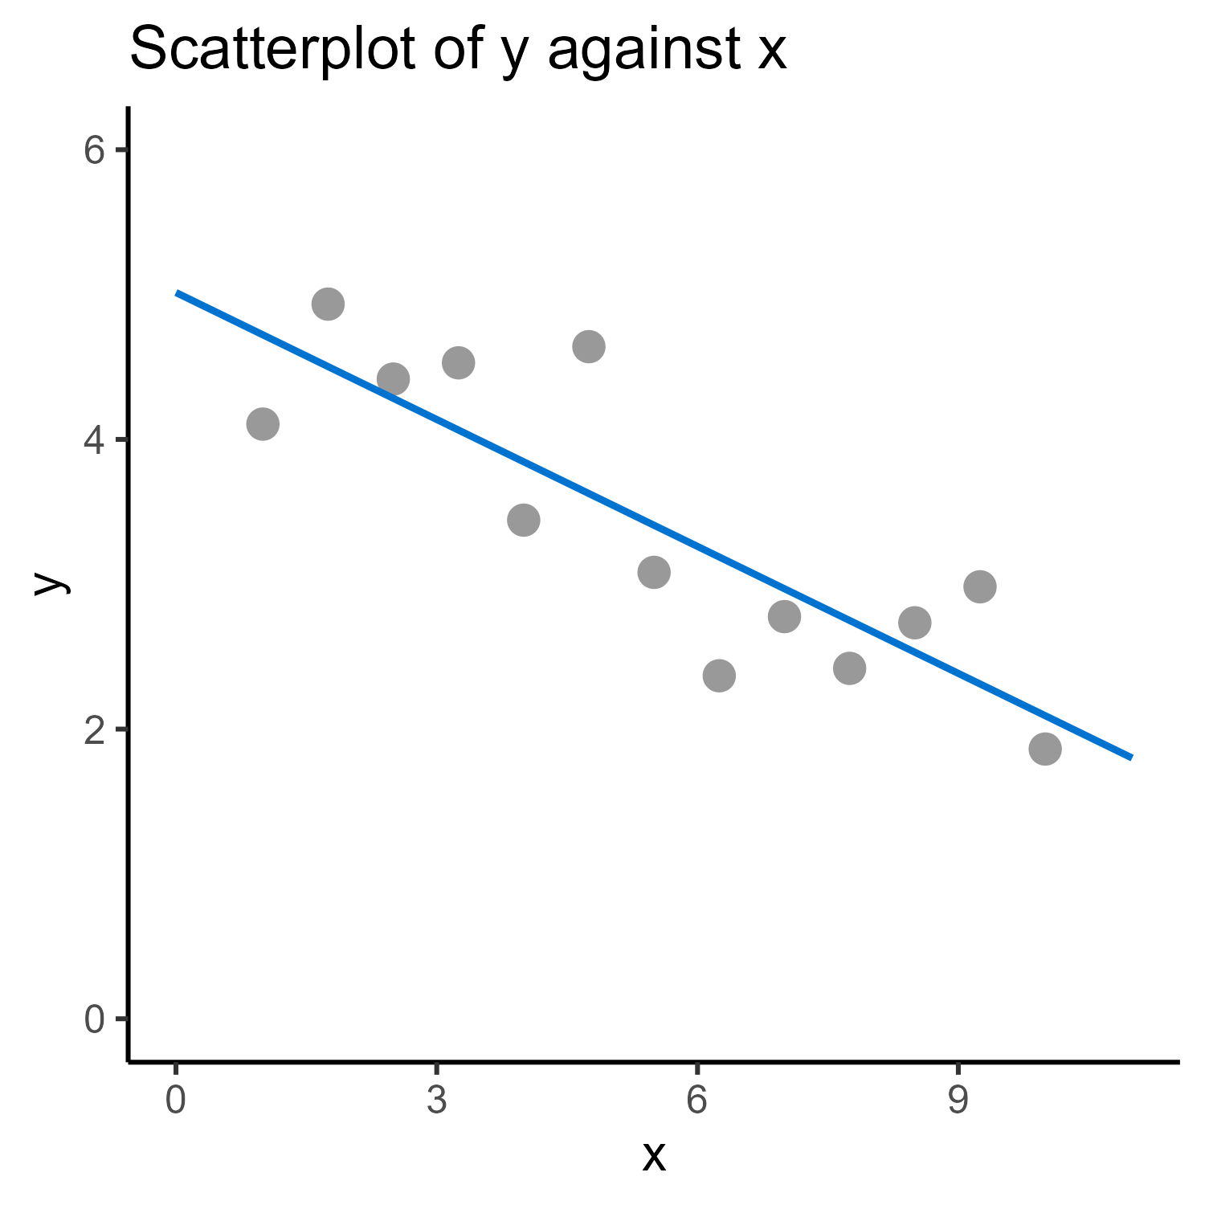
Line of best fit
The line of best fit is your “model”
Notes:
Model = an function that describes the pattern/trend in the dataset

Slide 27
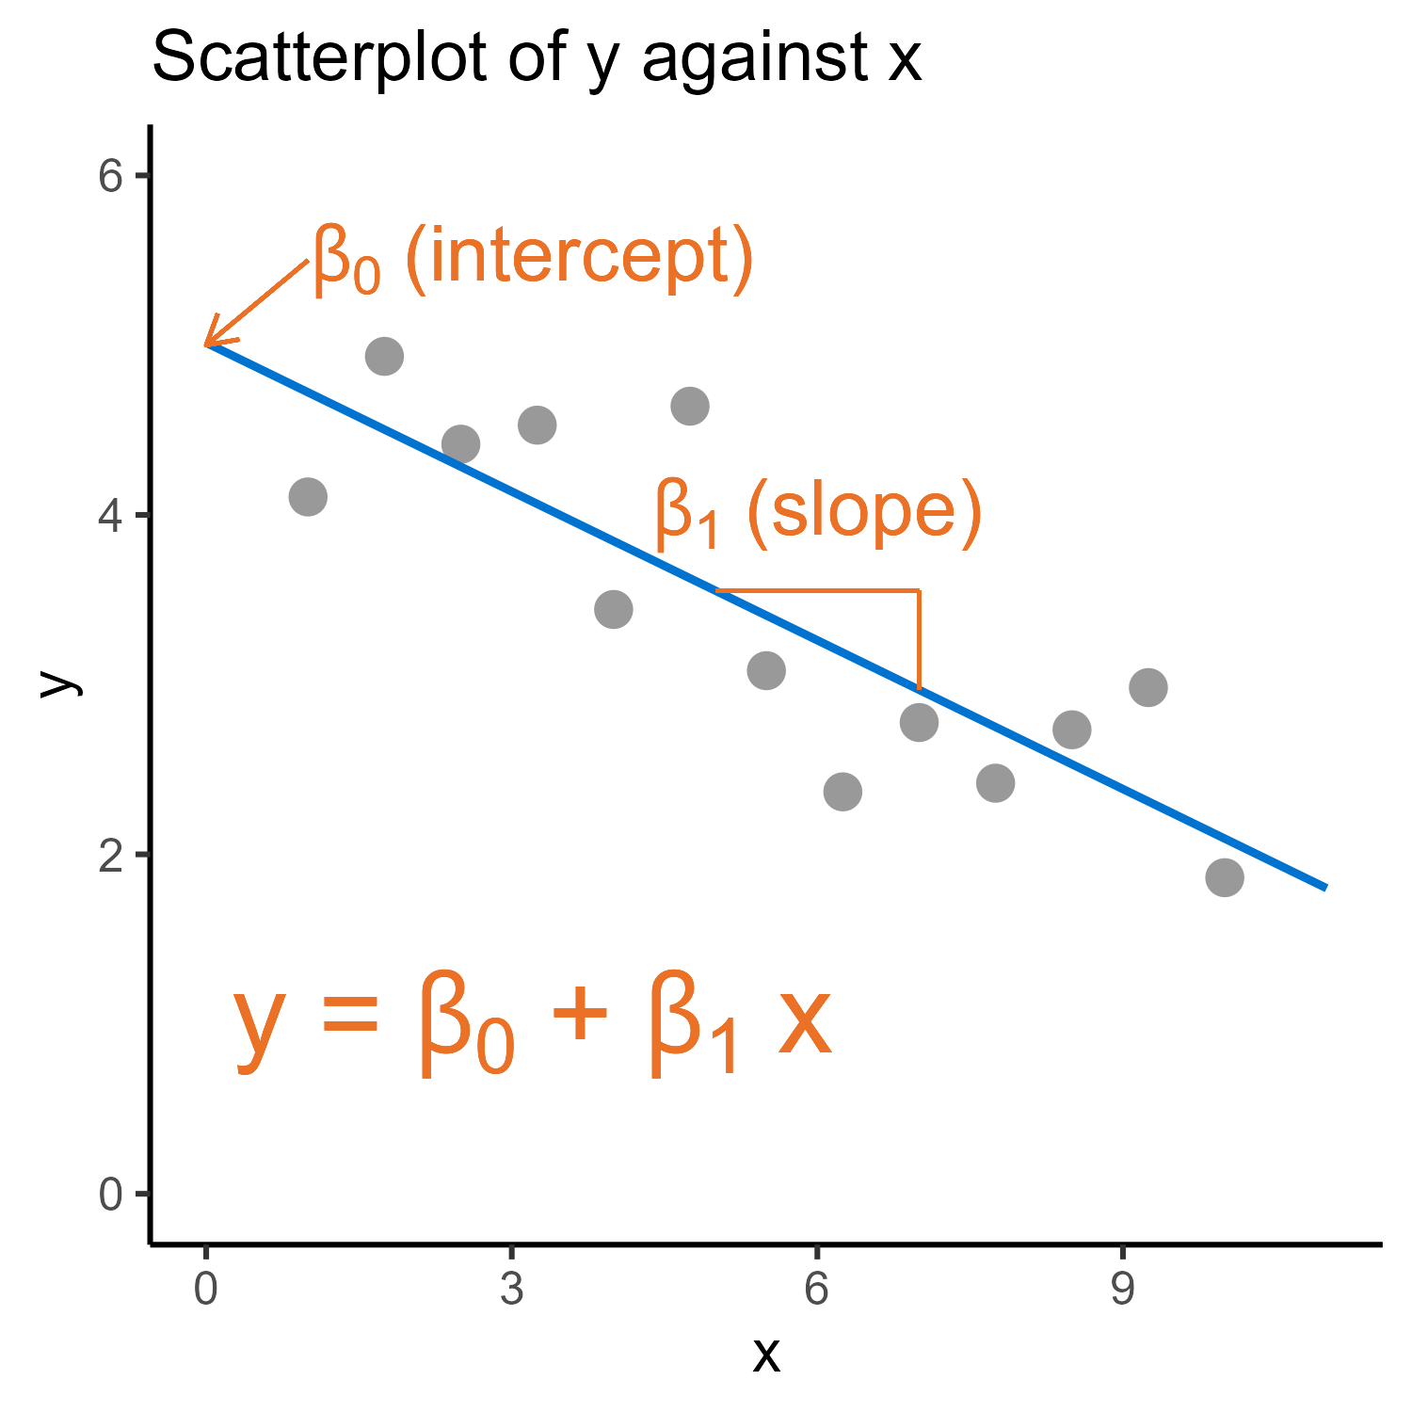
Line of best fit

Slide 28
Line of best fit

Slide 29
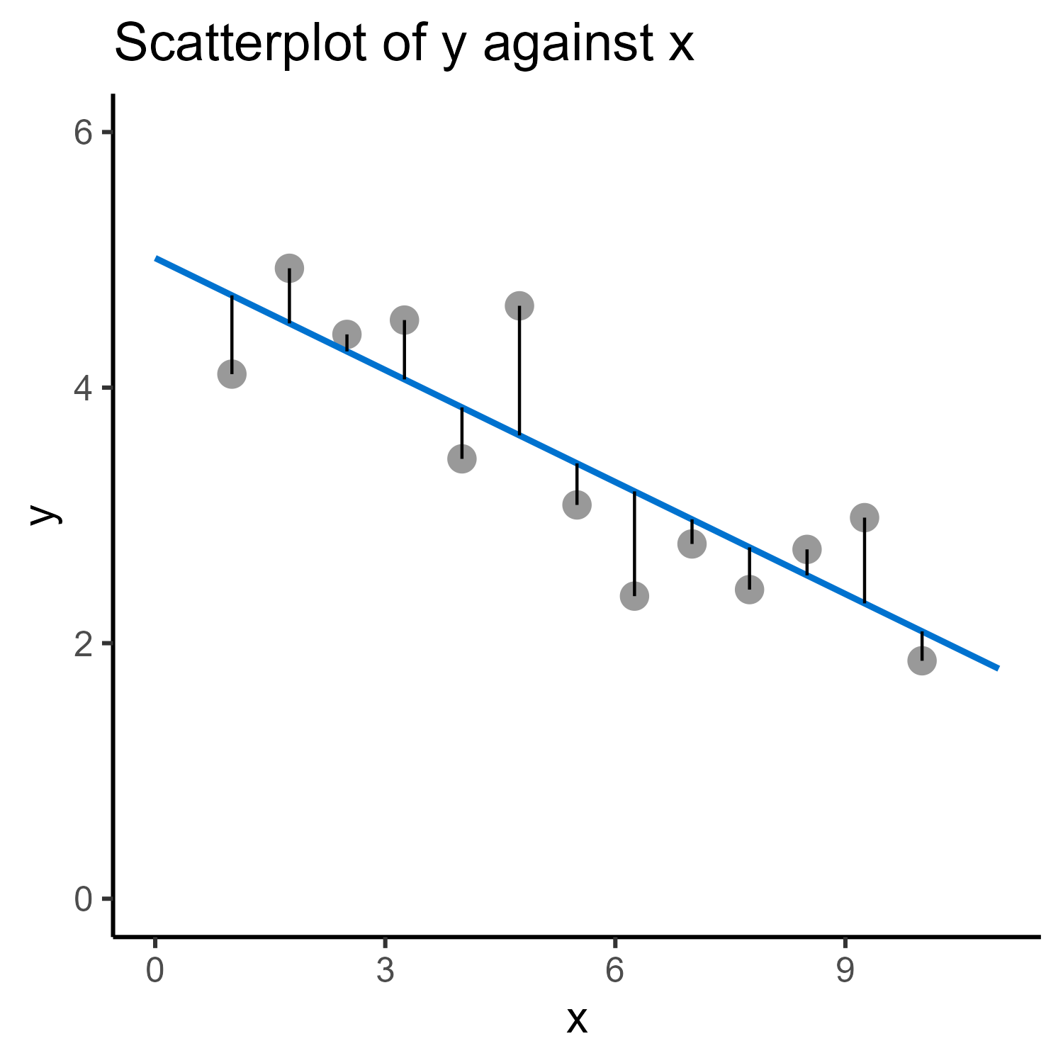
Line of best fit
Notes:
No model is perfect – always some errors

Slide 30
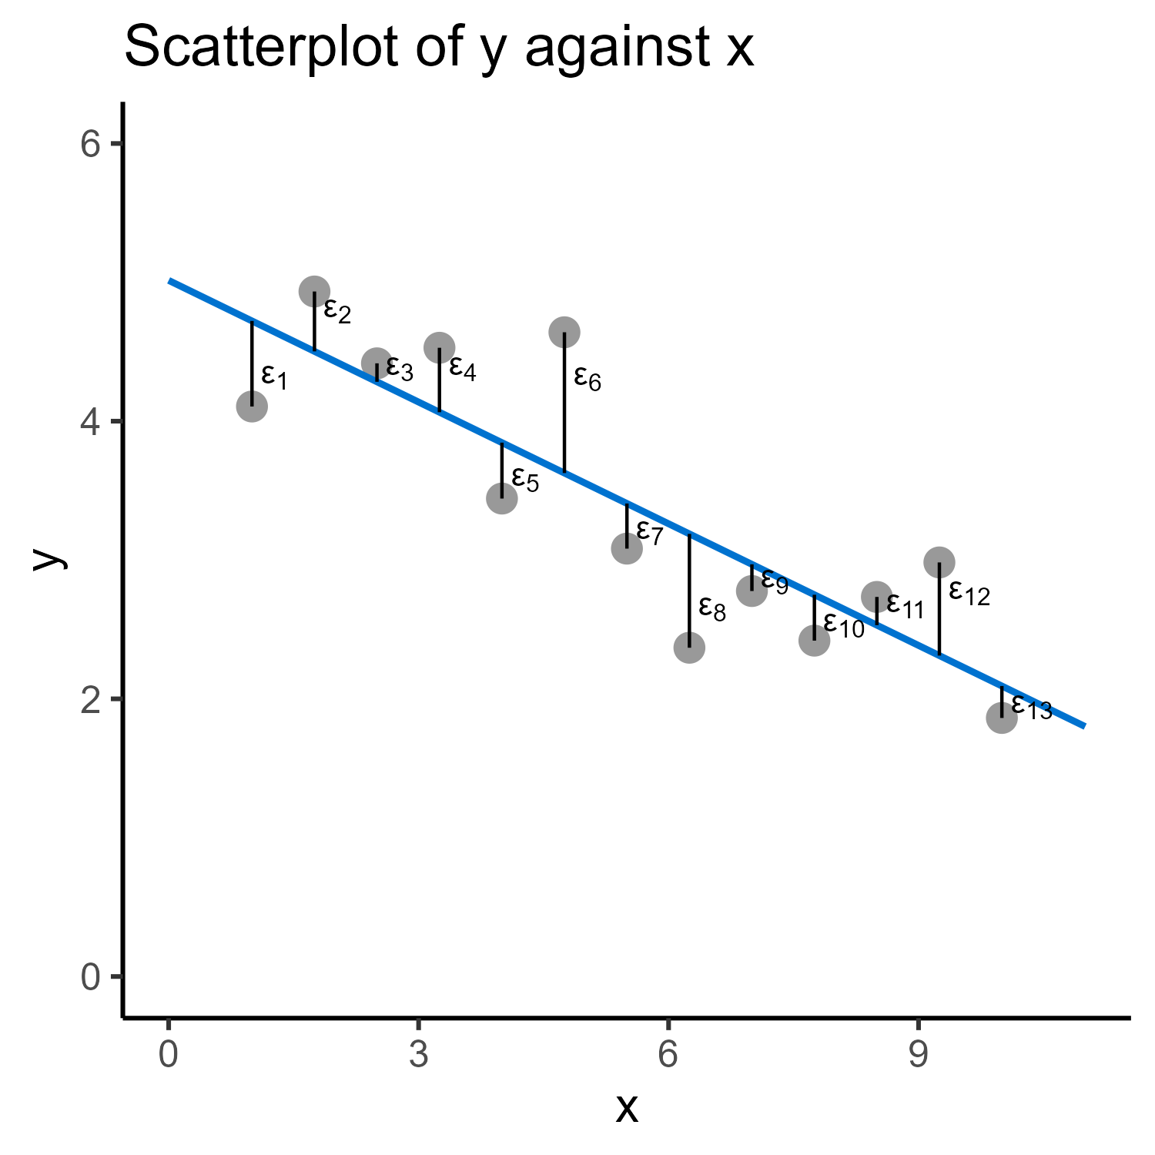
Line of best fit
Residuals are the difference between the model and the data
Notes:
We call those errors residuals

Slide 31
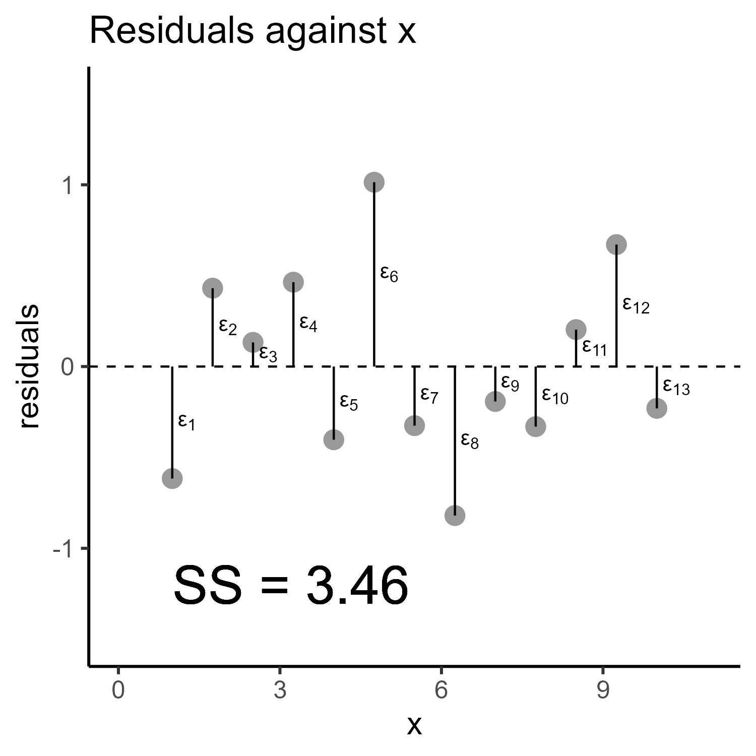
Line of best fit

Slide 32
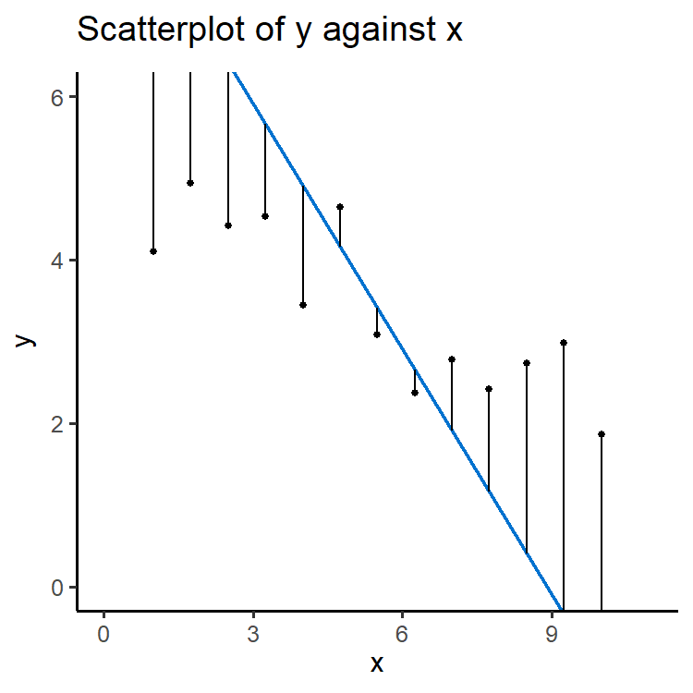
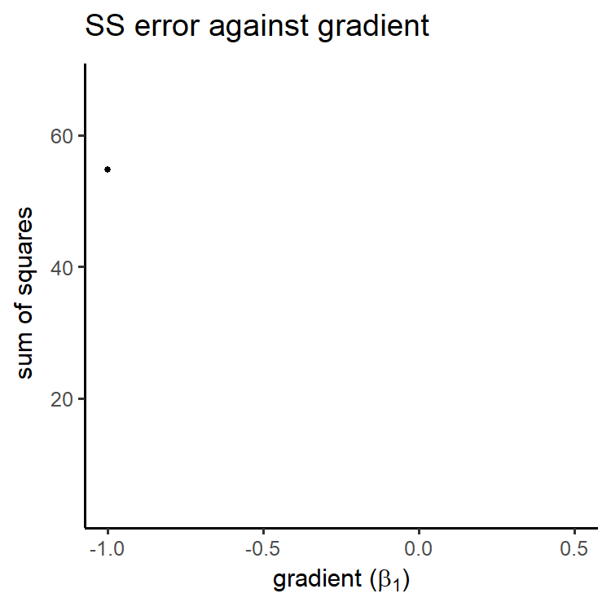
Line of best fit

Slide 33
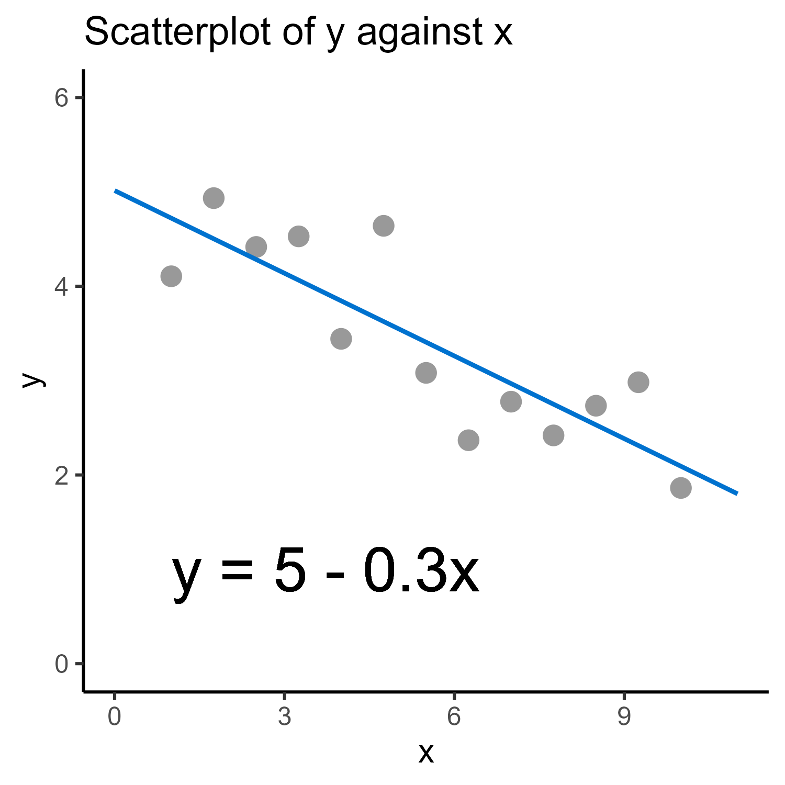
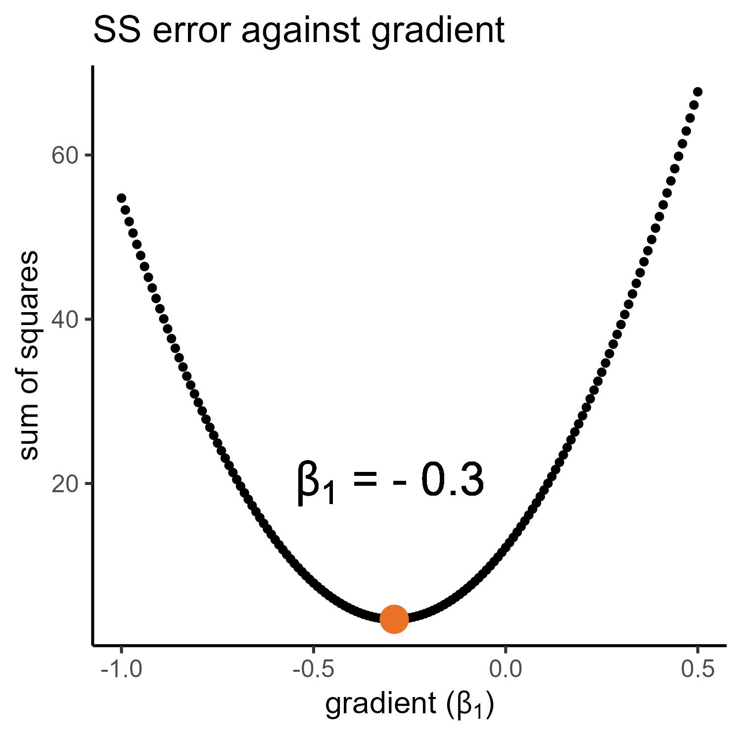
Line of best fit

Slide 34
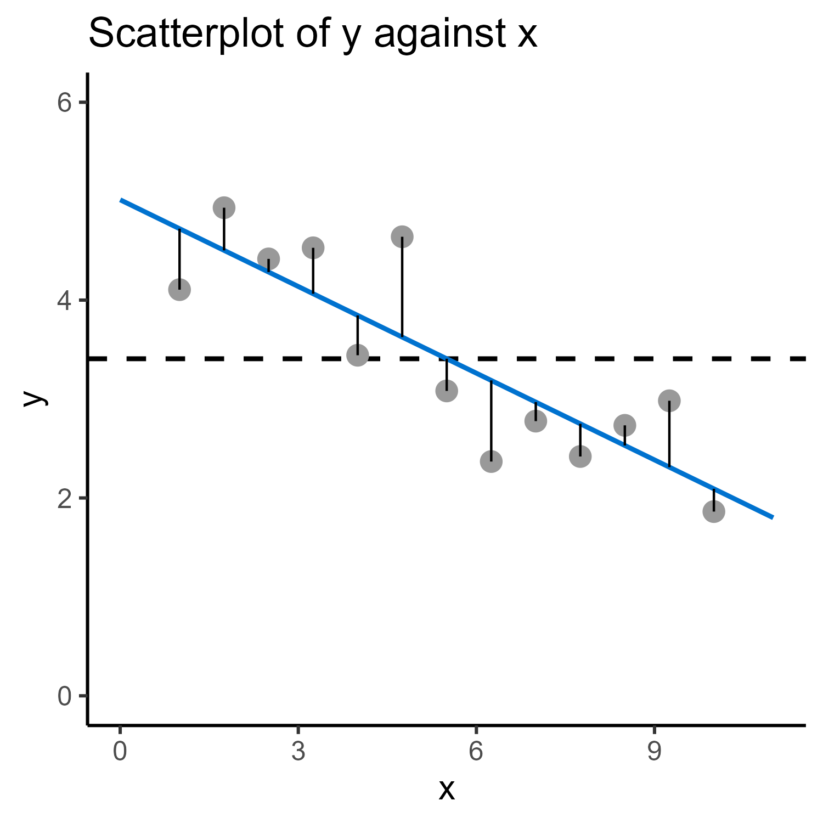
Regression analysis
Regression/significance testing involves comparing our alternative model to a null model
Notes:
That’s exactly what we’re doing here
On the left: split the model + error apart from each other

Slide 35
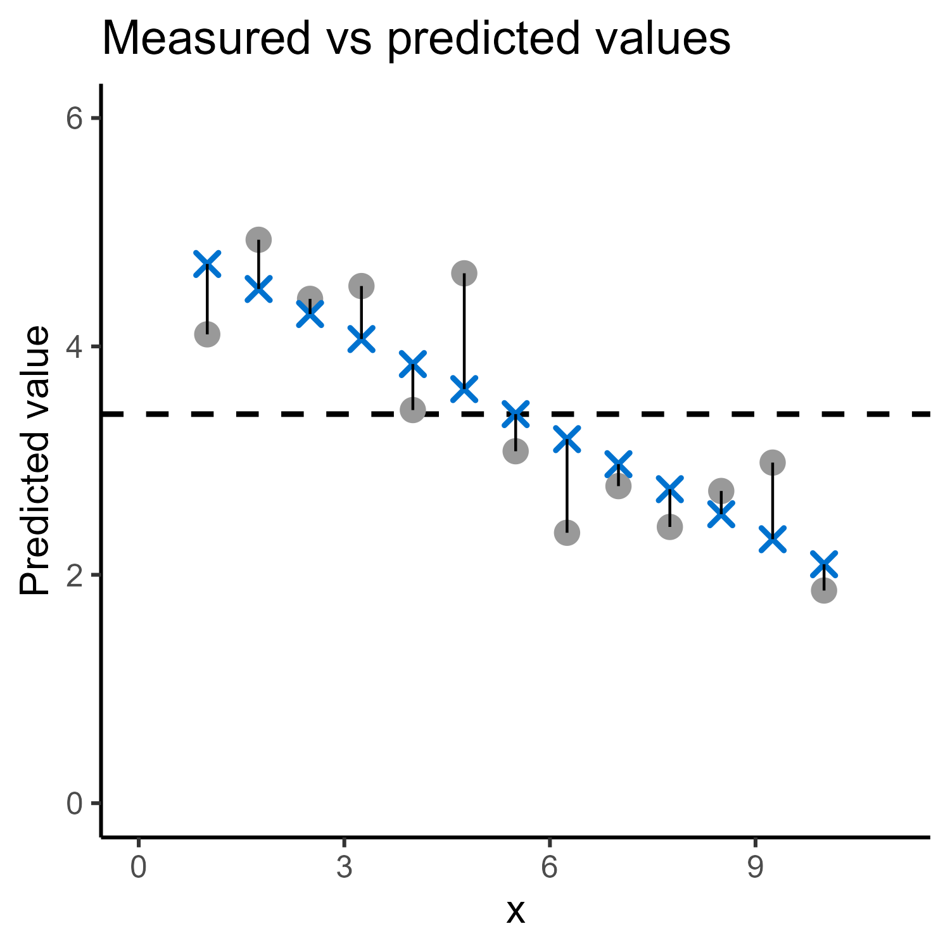
Regression analysis
Data = model + error
Notes:
That’s exactly what we’re doing here
On the left: split the model + error apart from each other

Slide 36
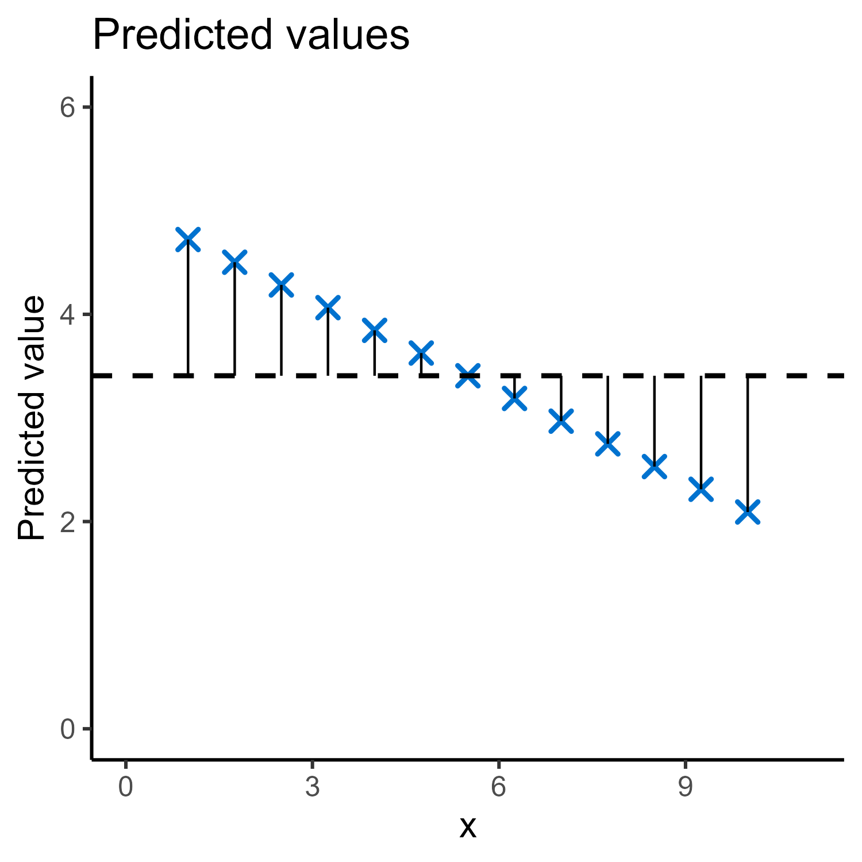
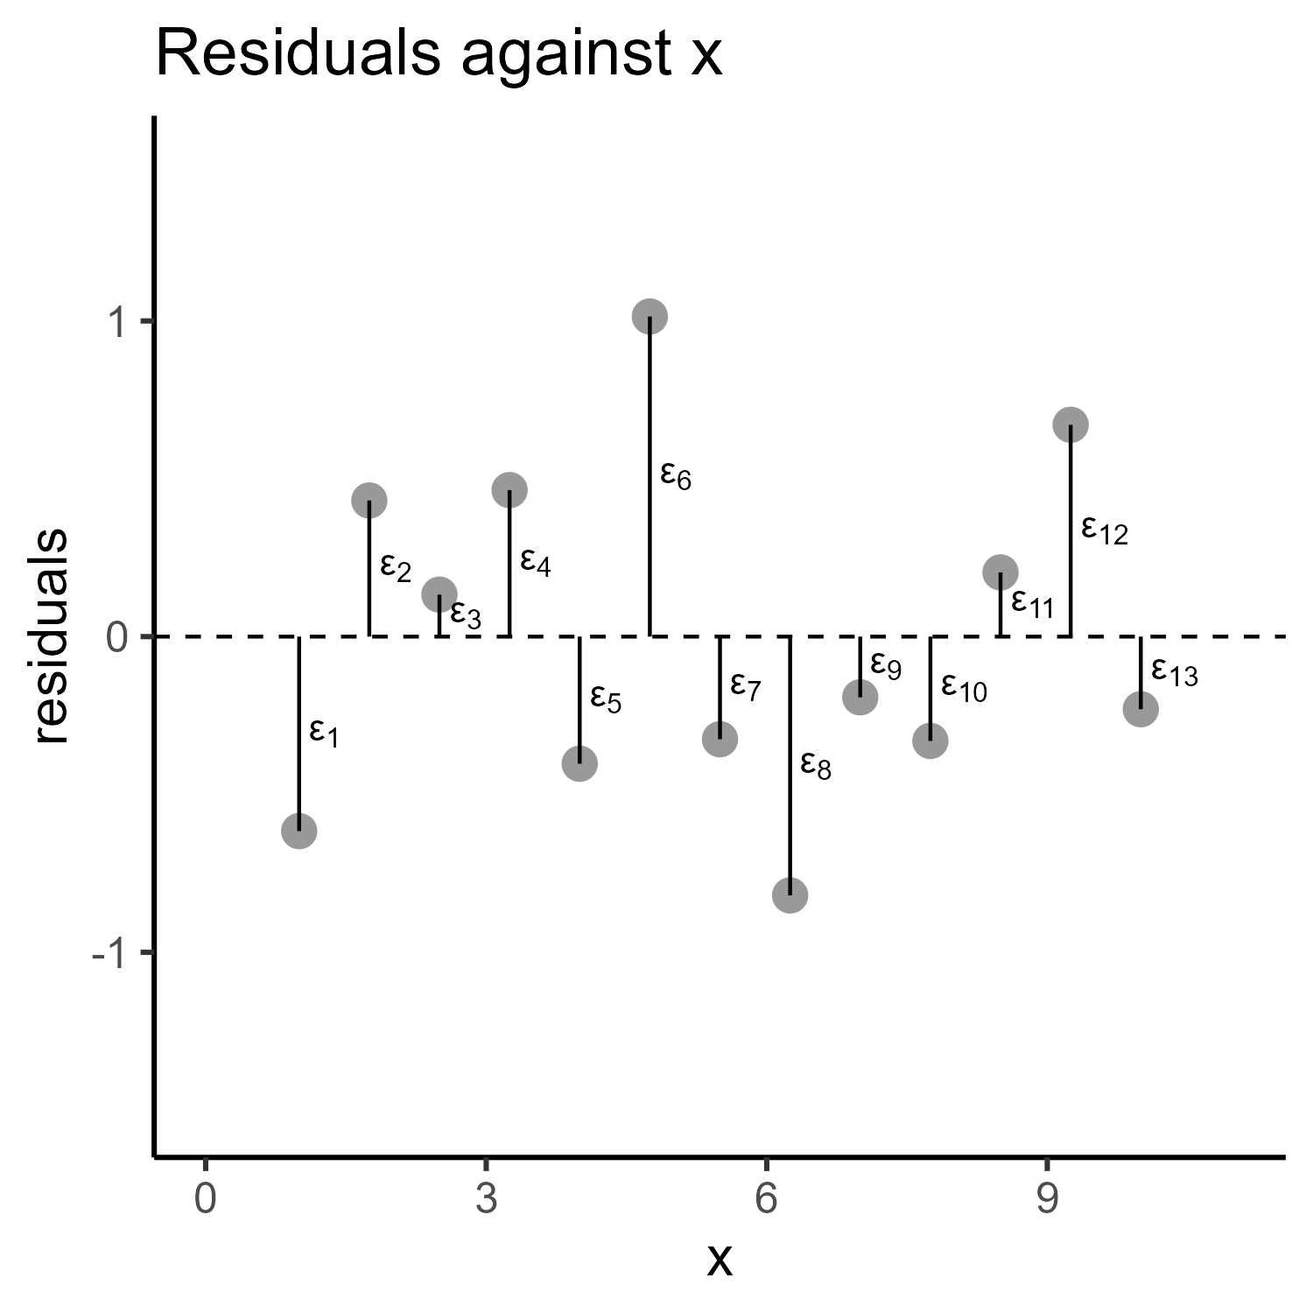
Regression analysis
“signal”
“noise”

Slide 37
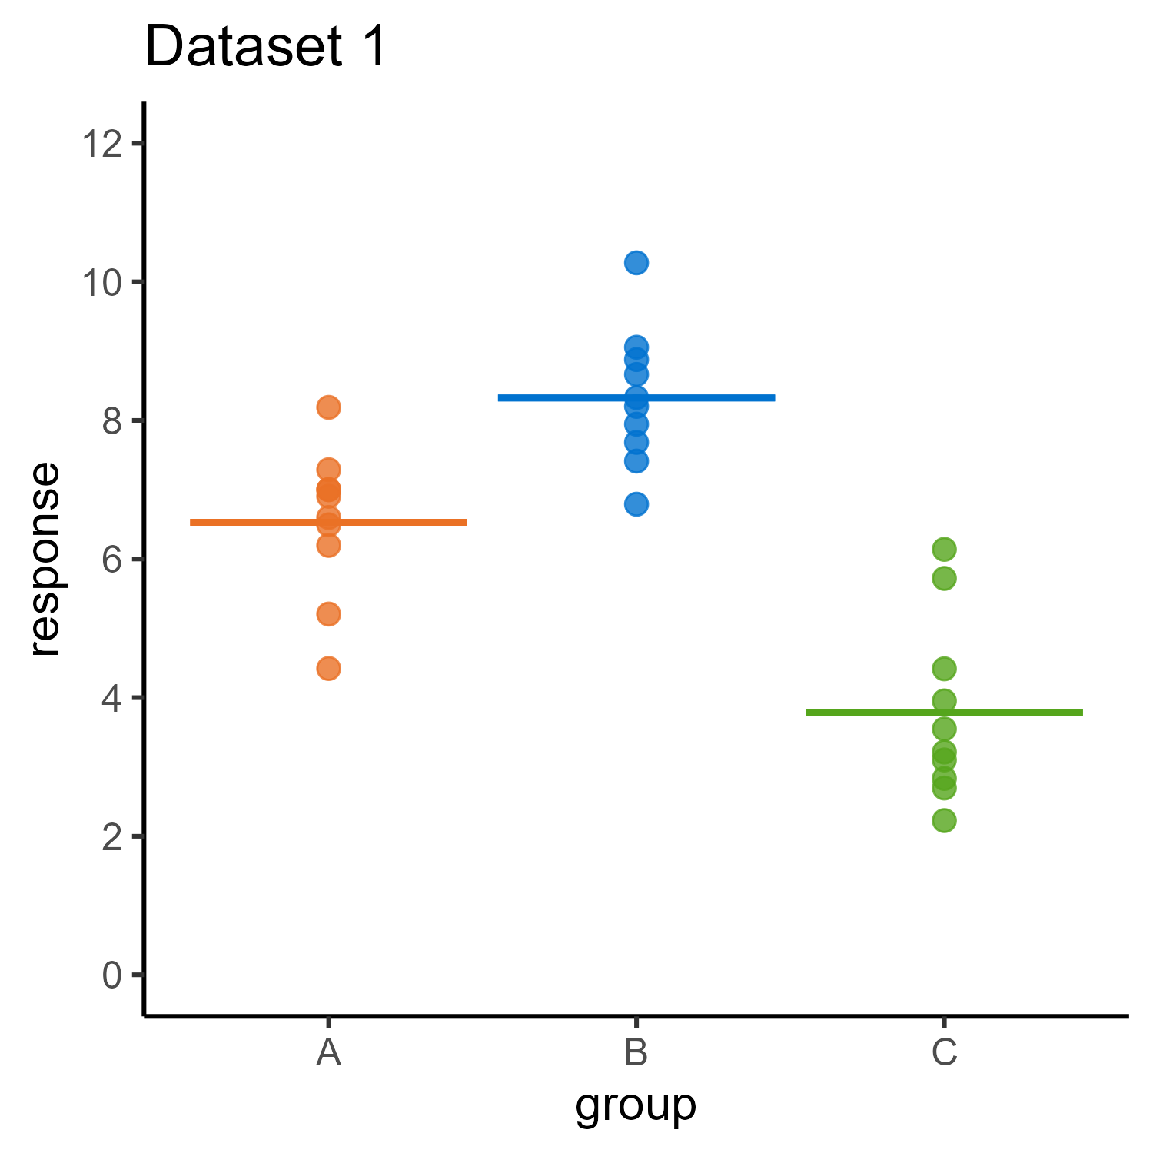
Categorical predictors
3 groups
10 points per group
Equal variances
Is there a difference between the means?

Slide 38
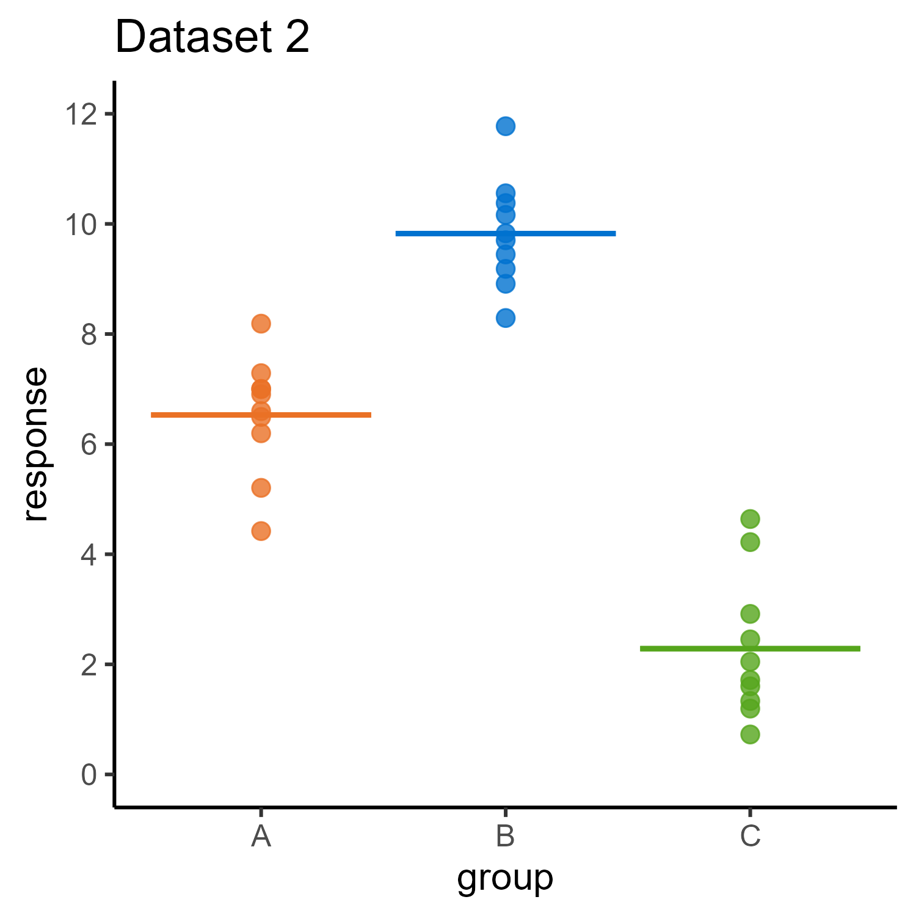
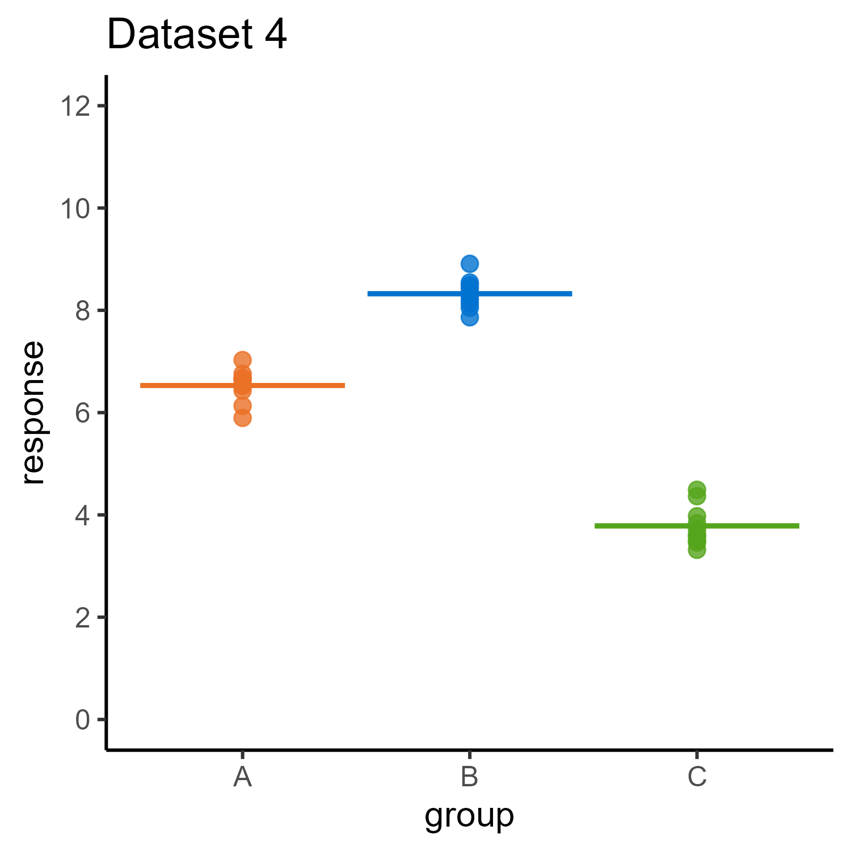
Categorical predictors
Groups different when the spread of means is big relative to spread of data

Slide 39
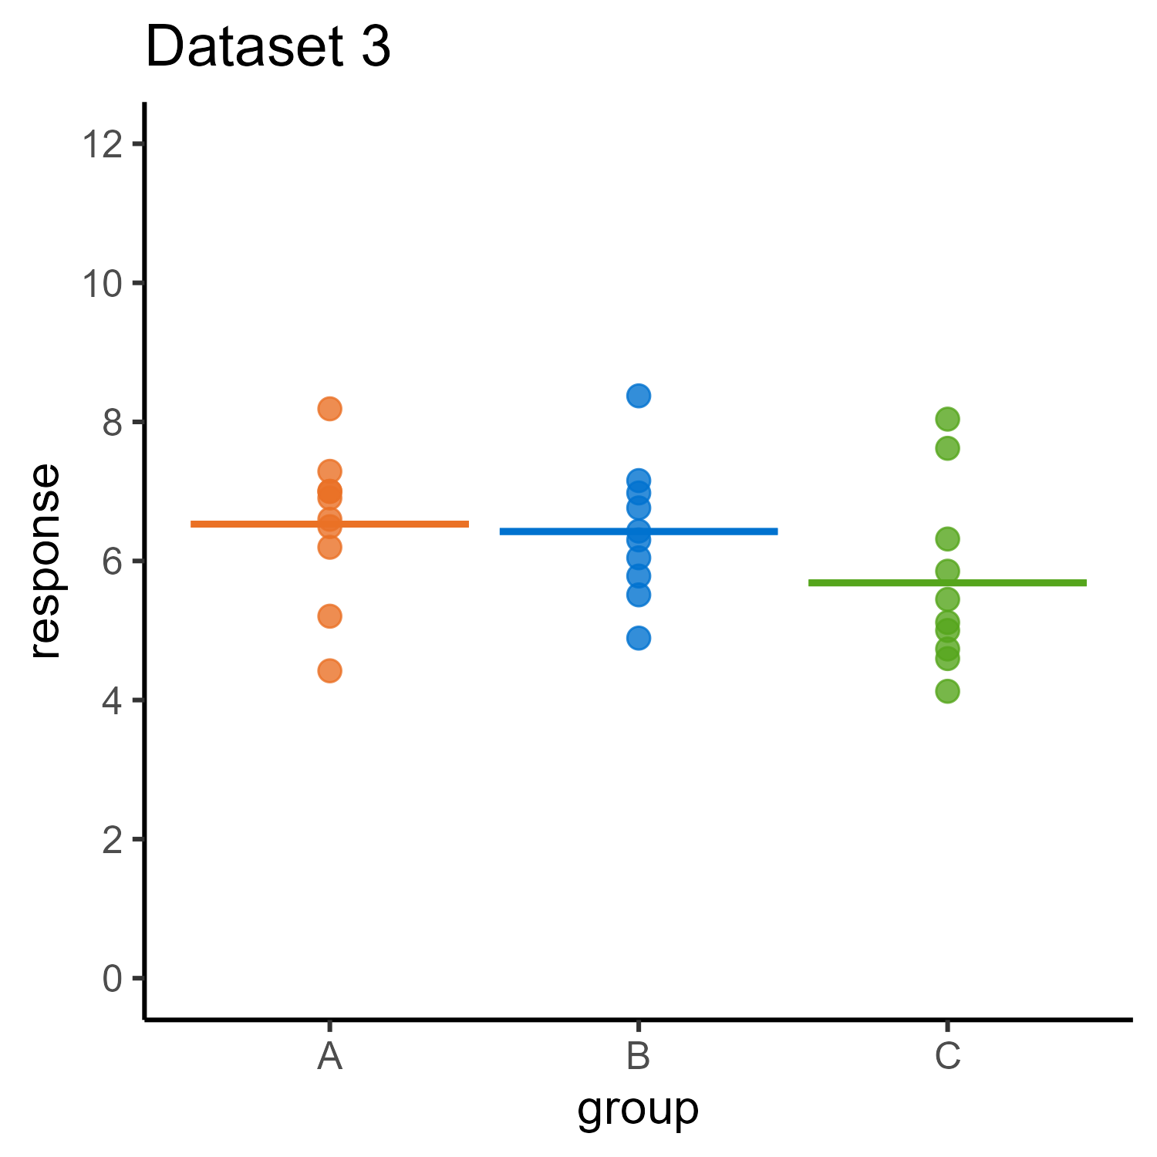
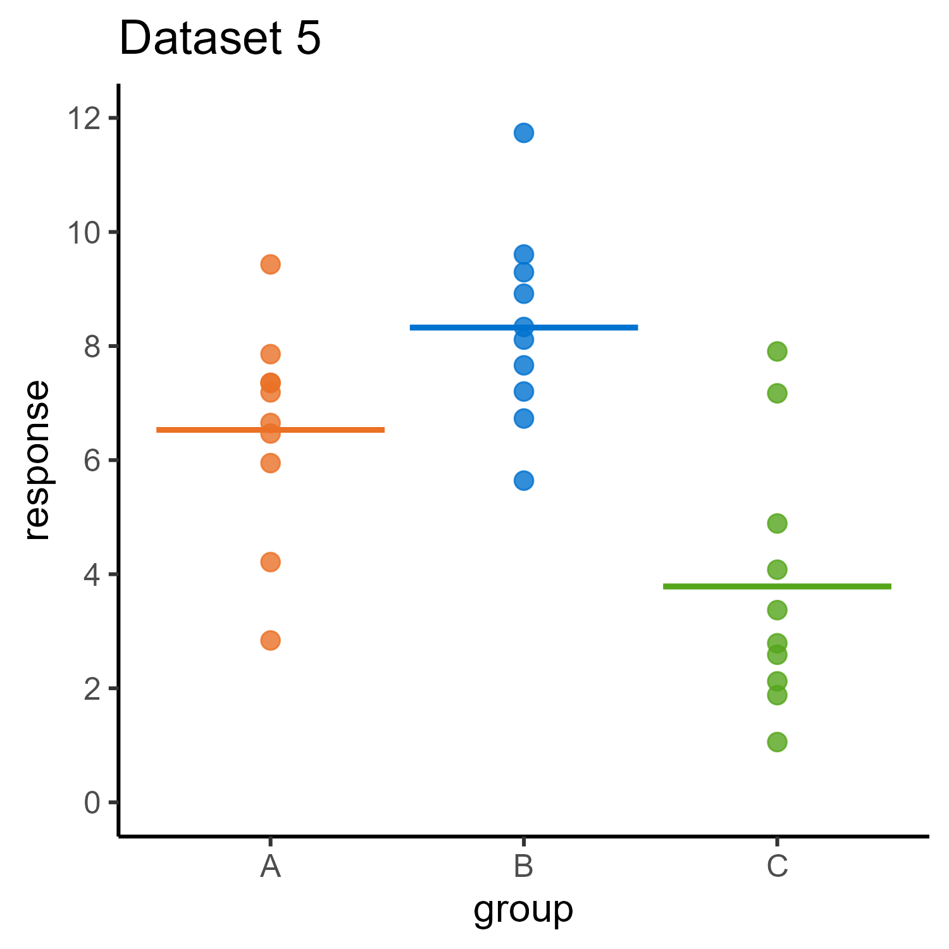
Categorical predictors
Groups not different when the spread of means is small relative to spread of data

Slide 40
Categorical predictors
Data = predictions + residuals = model + errors = signal + noise

Slide 41
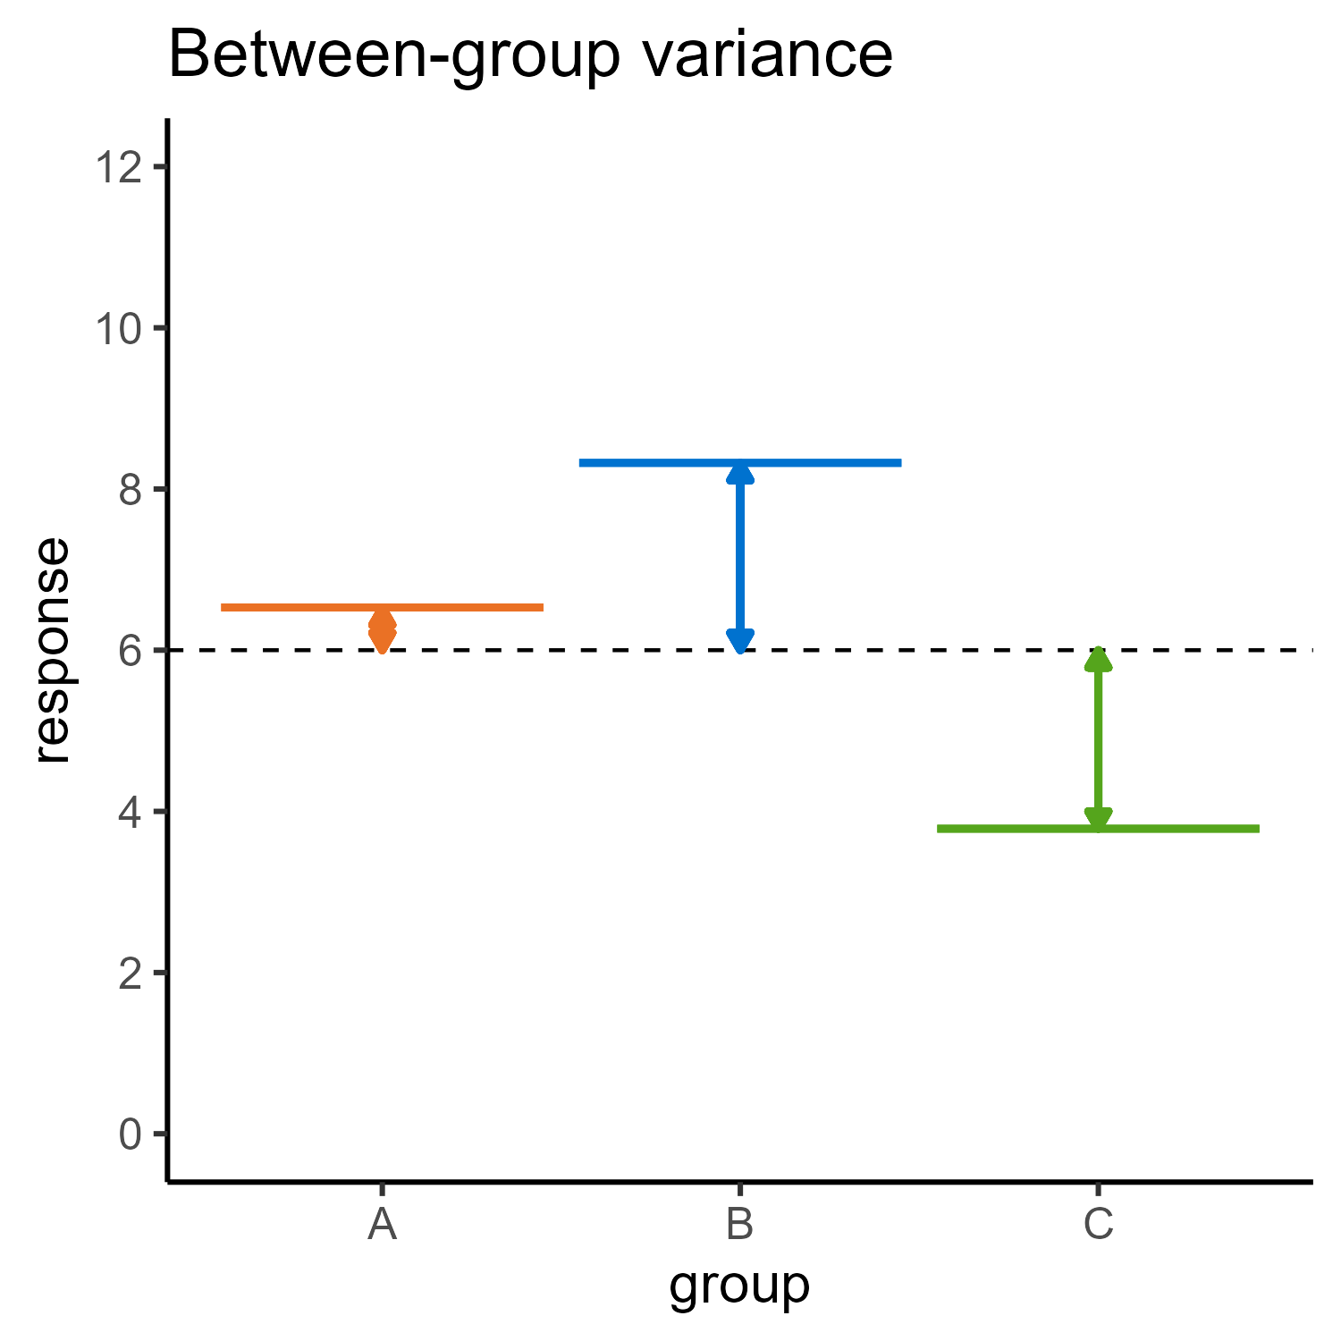
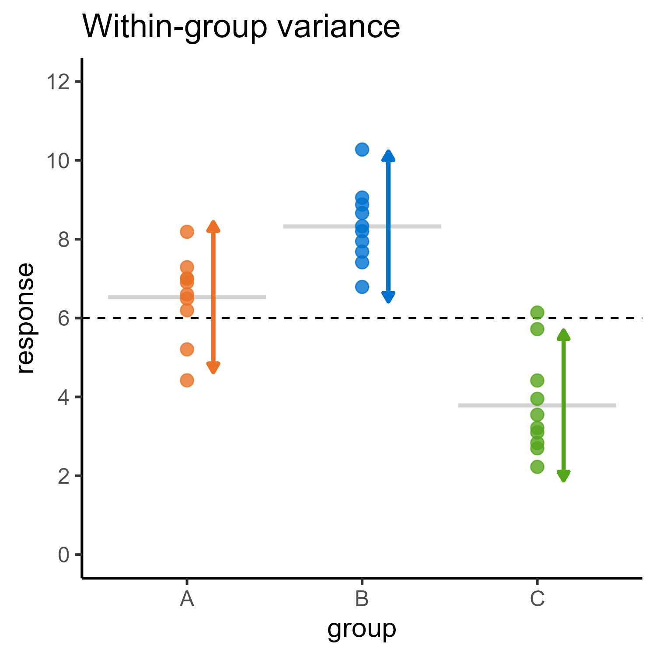
Categorical predictors
How much do the means vary between groups…
… compared with the data within each group?

Slide 42
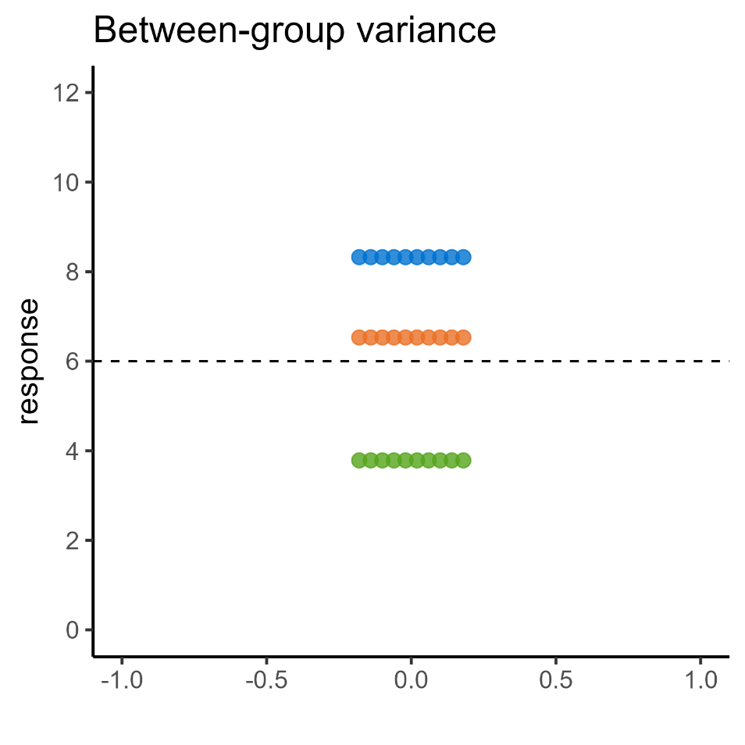
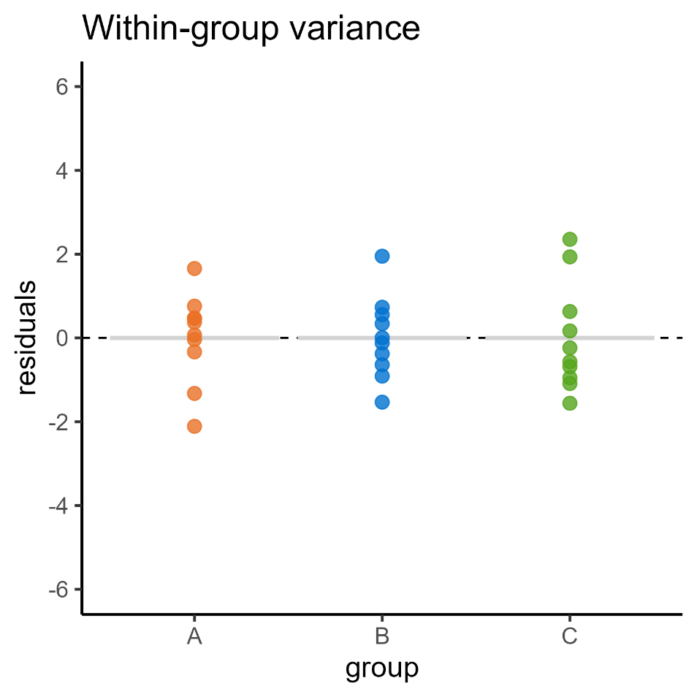
Categorical predictors
“signal”
“noise”
Predicted values (group means) relative to global mean
Group data relative to group means

Slide 43
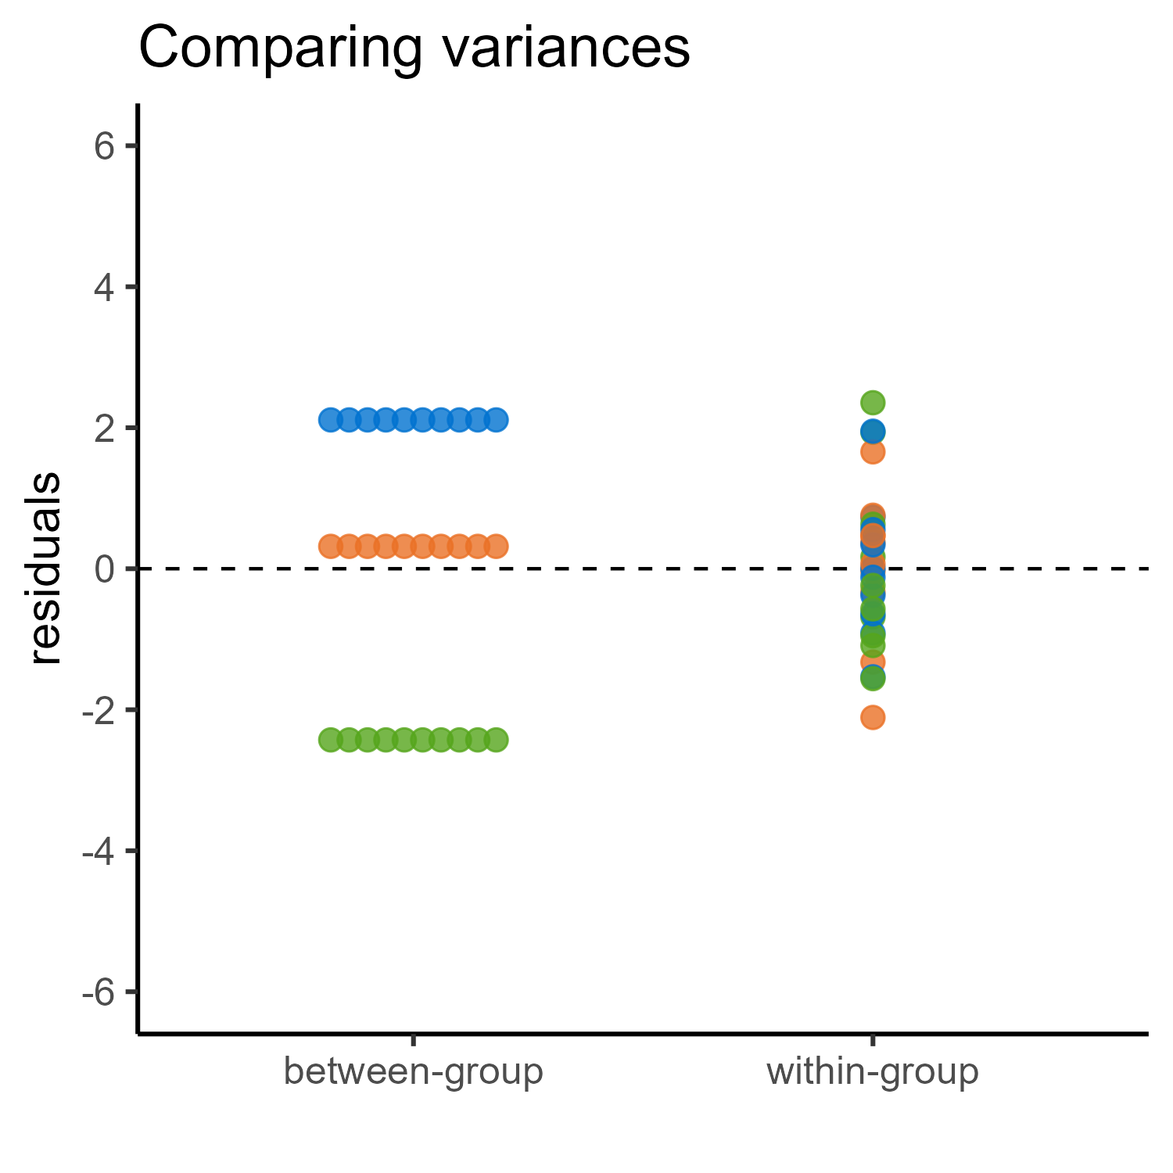
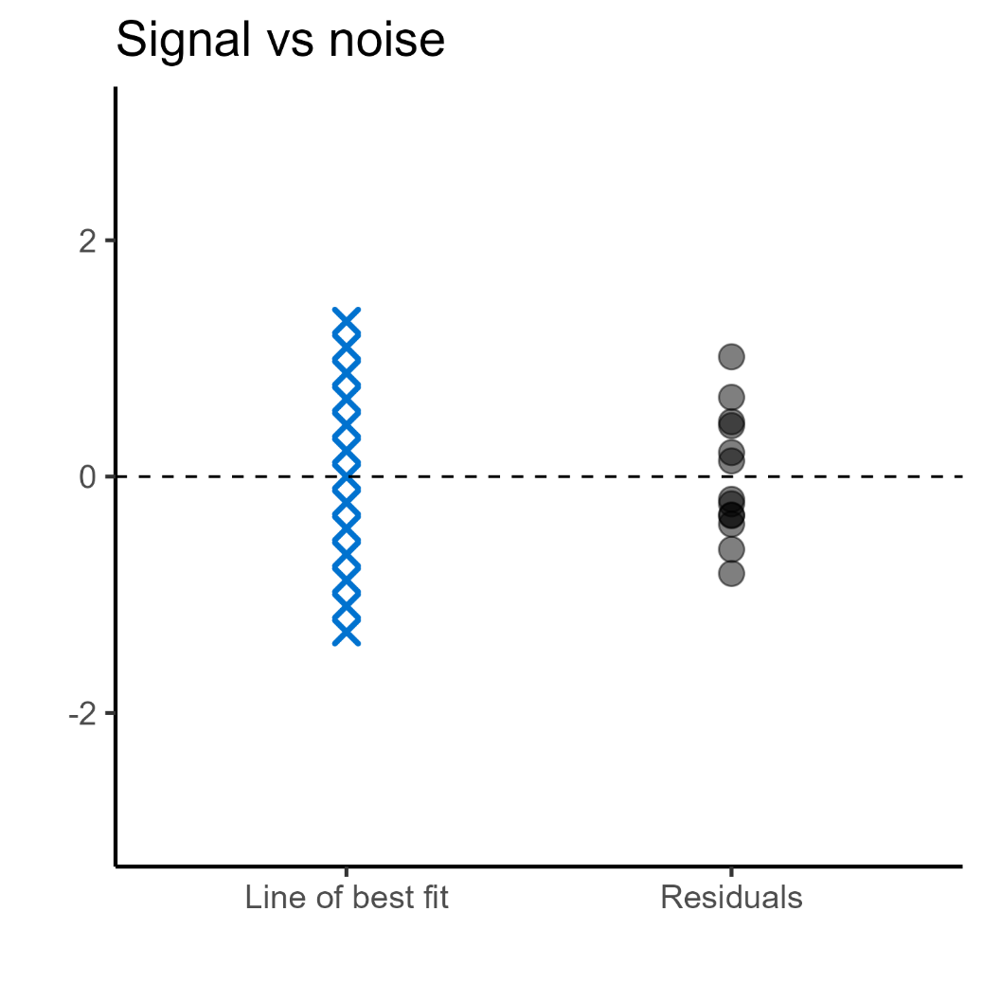
ANalysis Of VAriance

Slide 44
ANalysis Of VAriance

Slide 45

ANalysis Of VAriance
Use variance to quantify strength of the signal and noise F statistic = signal-to-noise ratio

Slide 46
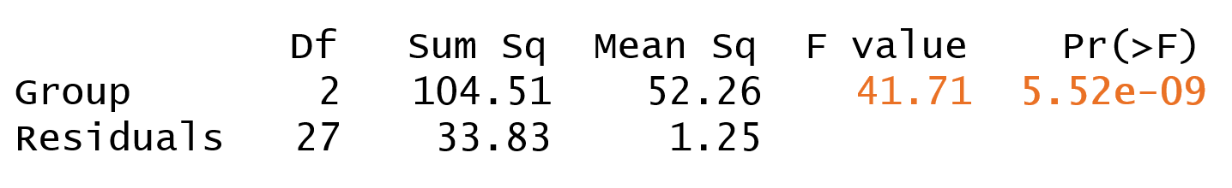
ANalysis Of VAriance
Signal-to-noise ratio (Ratio of variances)
Measure of whether this is a big/unlikely ratio

Slide 47
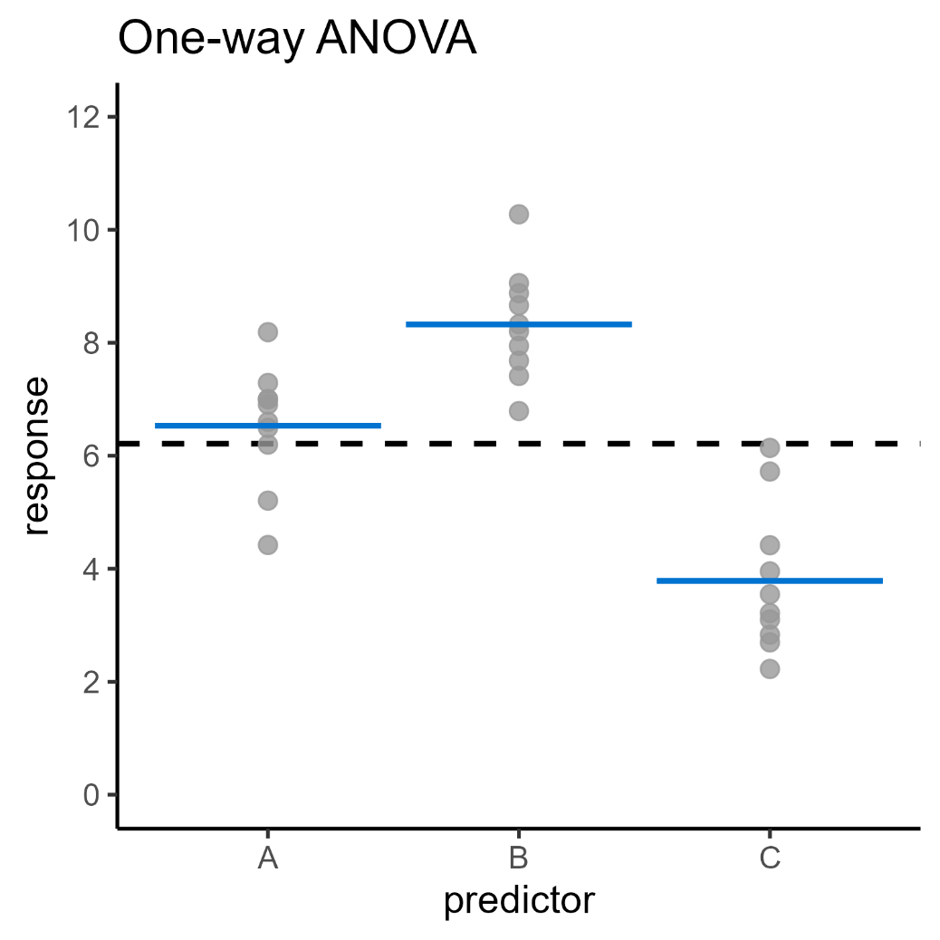
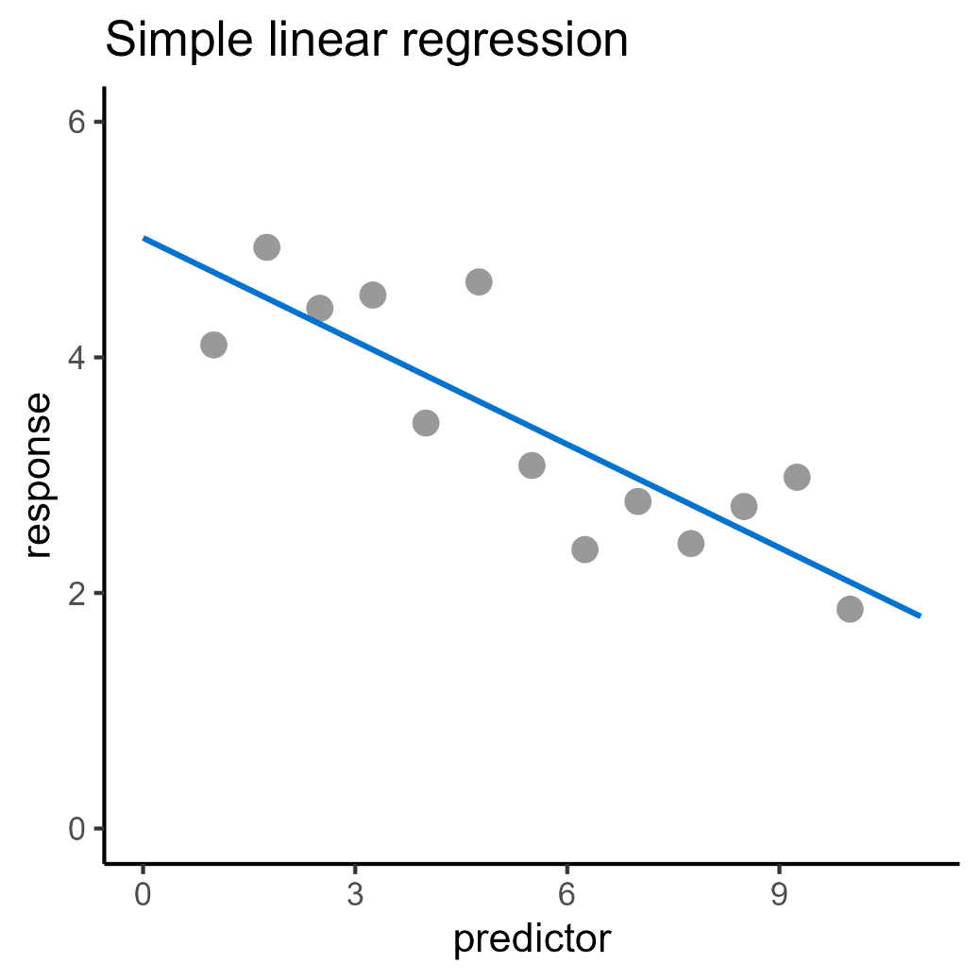
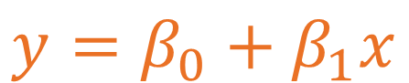

Linear modelling framework
$$y=β_{0}+β_{1}x$$
$$y=β_{0}+β_{1}x$$

Slide 48
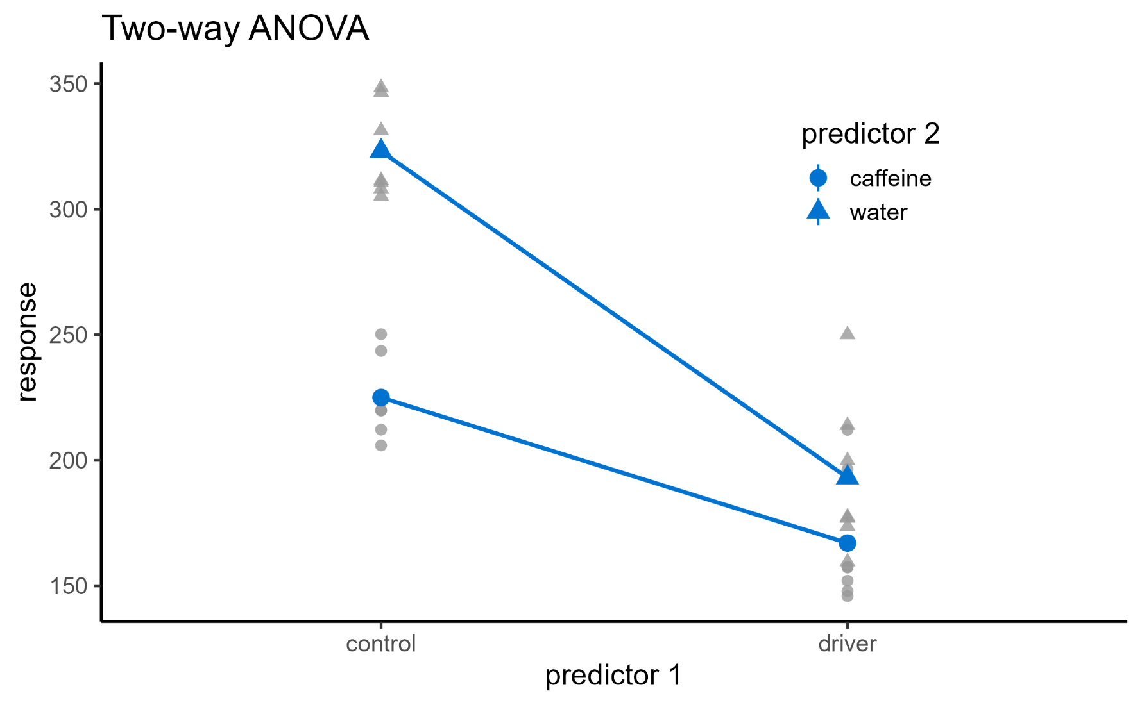
Linear modelling framework
$y=β_{0}+β_{1}x_{1}$ $+β_{2}x_{2}$ $+β_{3}x_{1}x_{2}$

Slide 49
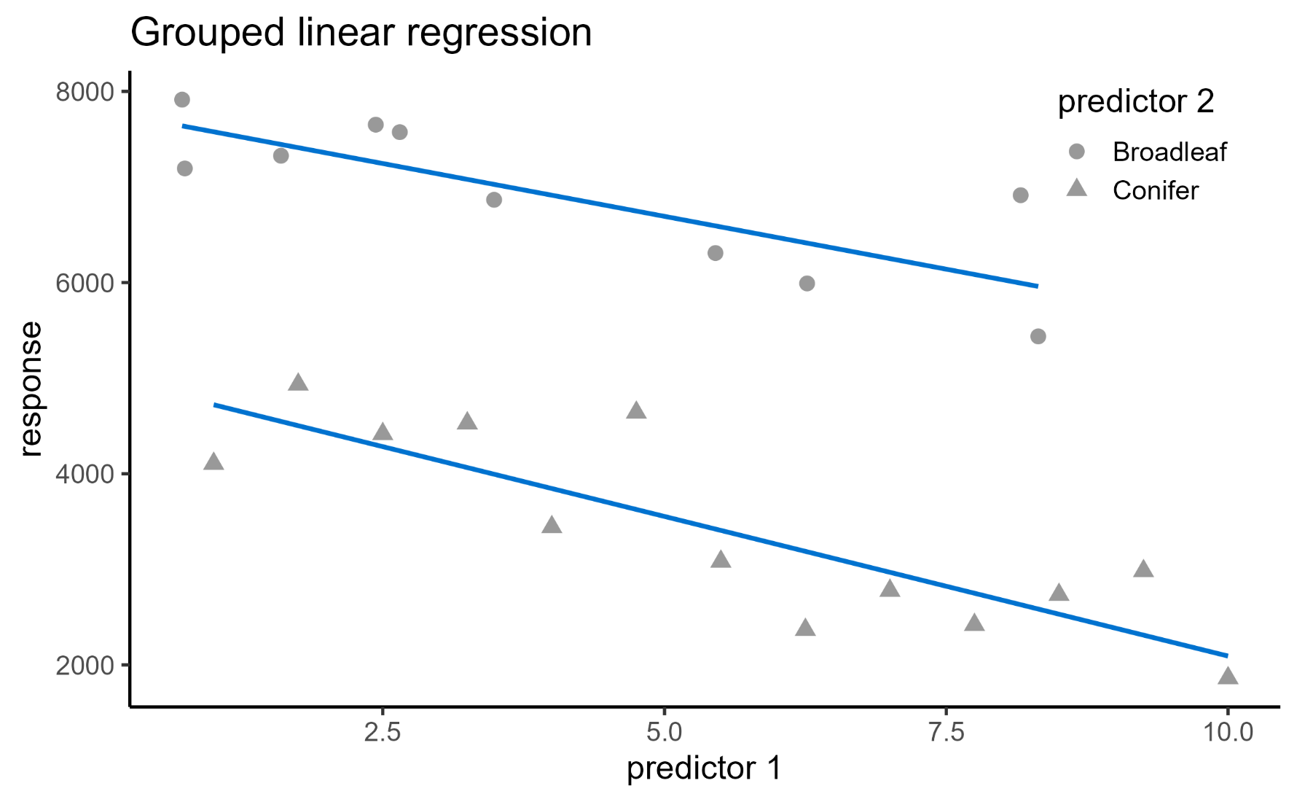
Linear modelling framework
$y=β_{0}+β_{1}x_{1}$ $+β_{2}x_{2}$ $+β_{3}x_{1}x_{2}$

Slide 50
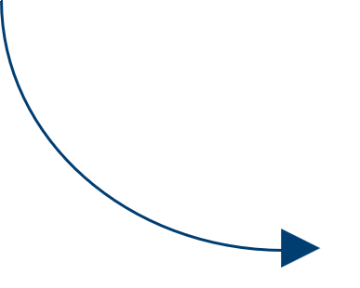

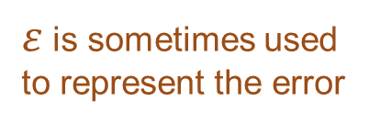
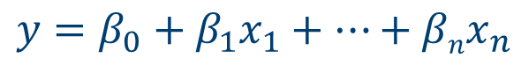
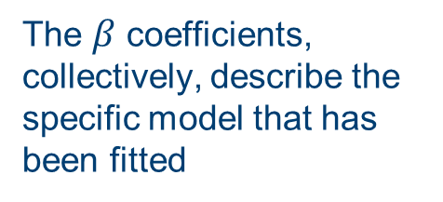
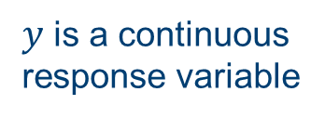
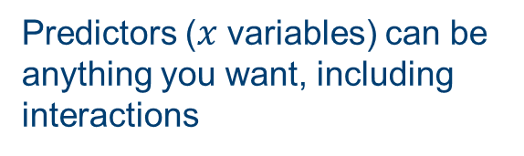
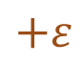
Linear modelling framework
$y$ is a continuous response variable
Predictors ($x$ variables) can be anything you want, including interactions
$$y=β_{0}+β_{1}x_{1}+…+βnx_{n}$$
$$+ε$$
The $β$ coefficients, collectively, describe the specific model that has been fitted
$ε$ is sometimes used to represent the error
Notes:
Error/residuals – an estimate of the difference between the model and the true population value(s)
→ Visualising this on the next slide as a reminder

Slide 51
Assumptions of a linear model
For a linear model, we are assuming:
Continuous response variable
Independent observations
Linear relationship (coefficients)
Homogeneity of variance in residuals
Normally distributed residuals
Lack of points with high leverage
Information you need to know about the dataset
Can be assessed using diagnostic plots
Notes:
Main takeaway from this slide: the linear model makes quite a few assumptions, and it’s easy to imagine situations where they don’t hold up

Slide 52
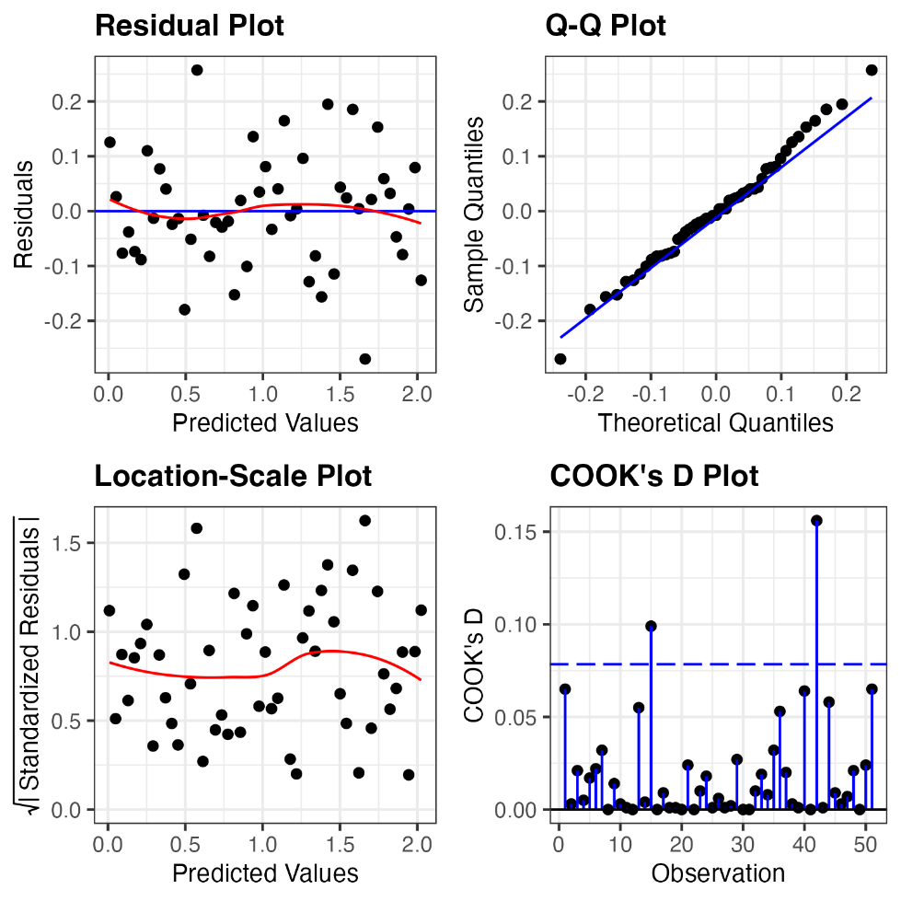
Assumptions of a linear model
Linearity
Normality
Equality of Variance
Influential Points

Slide 53
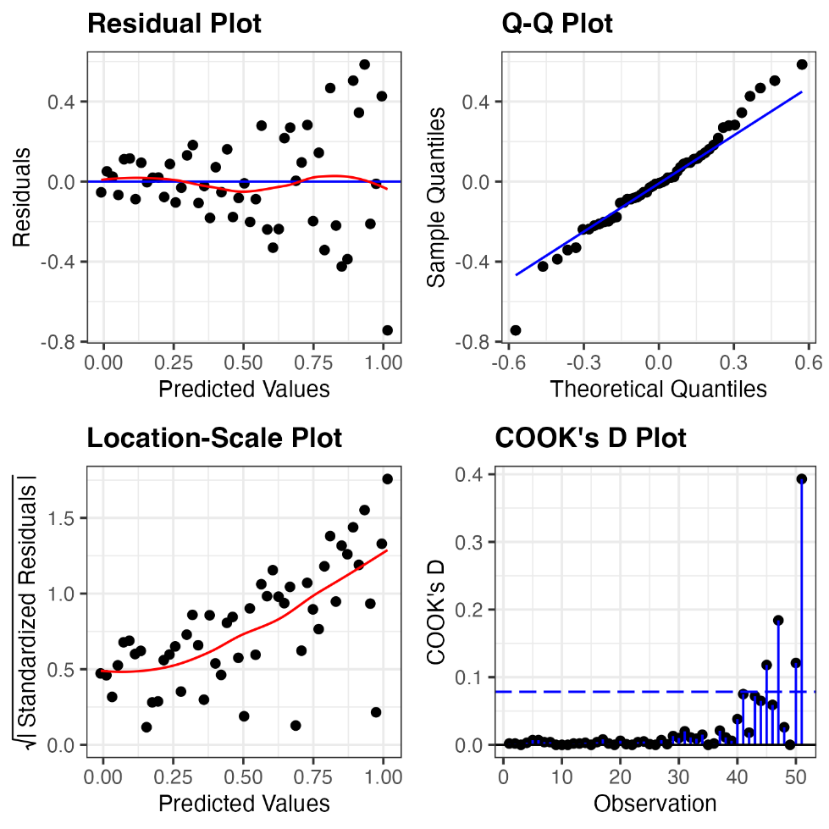
Assumptions of a linear model
Linearity
Normality
Equality of Variance
Influential Points

Slide 54
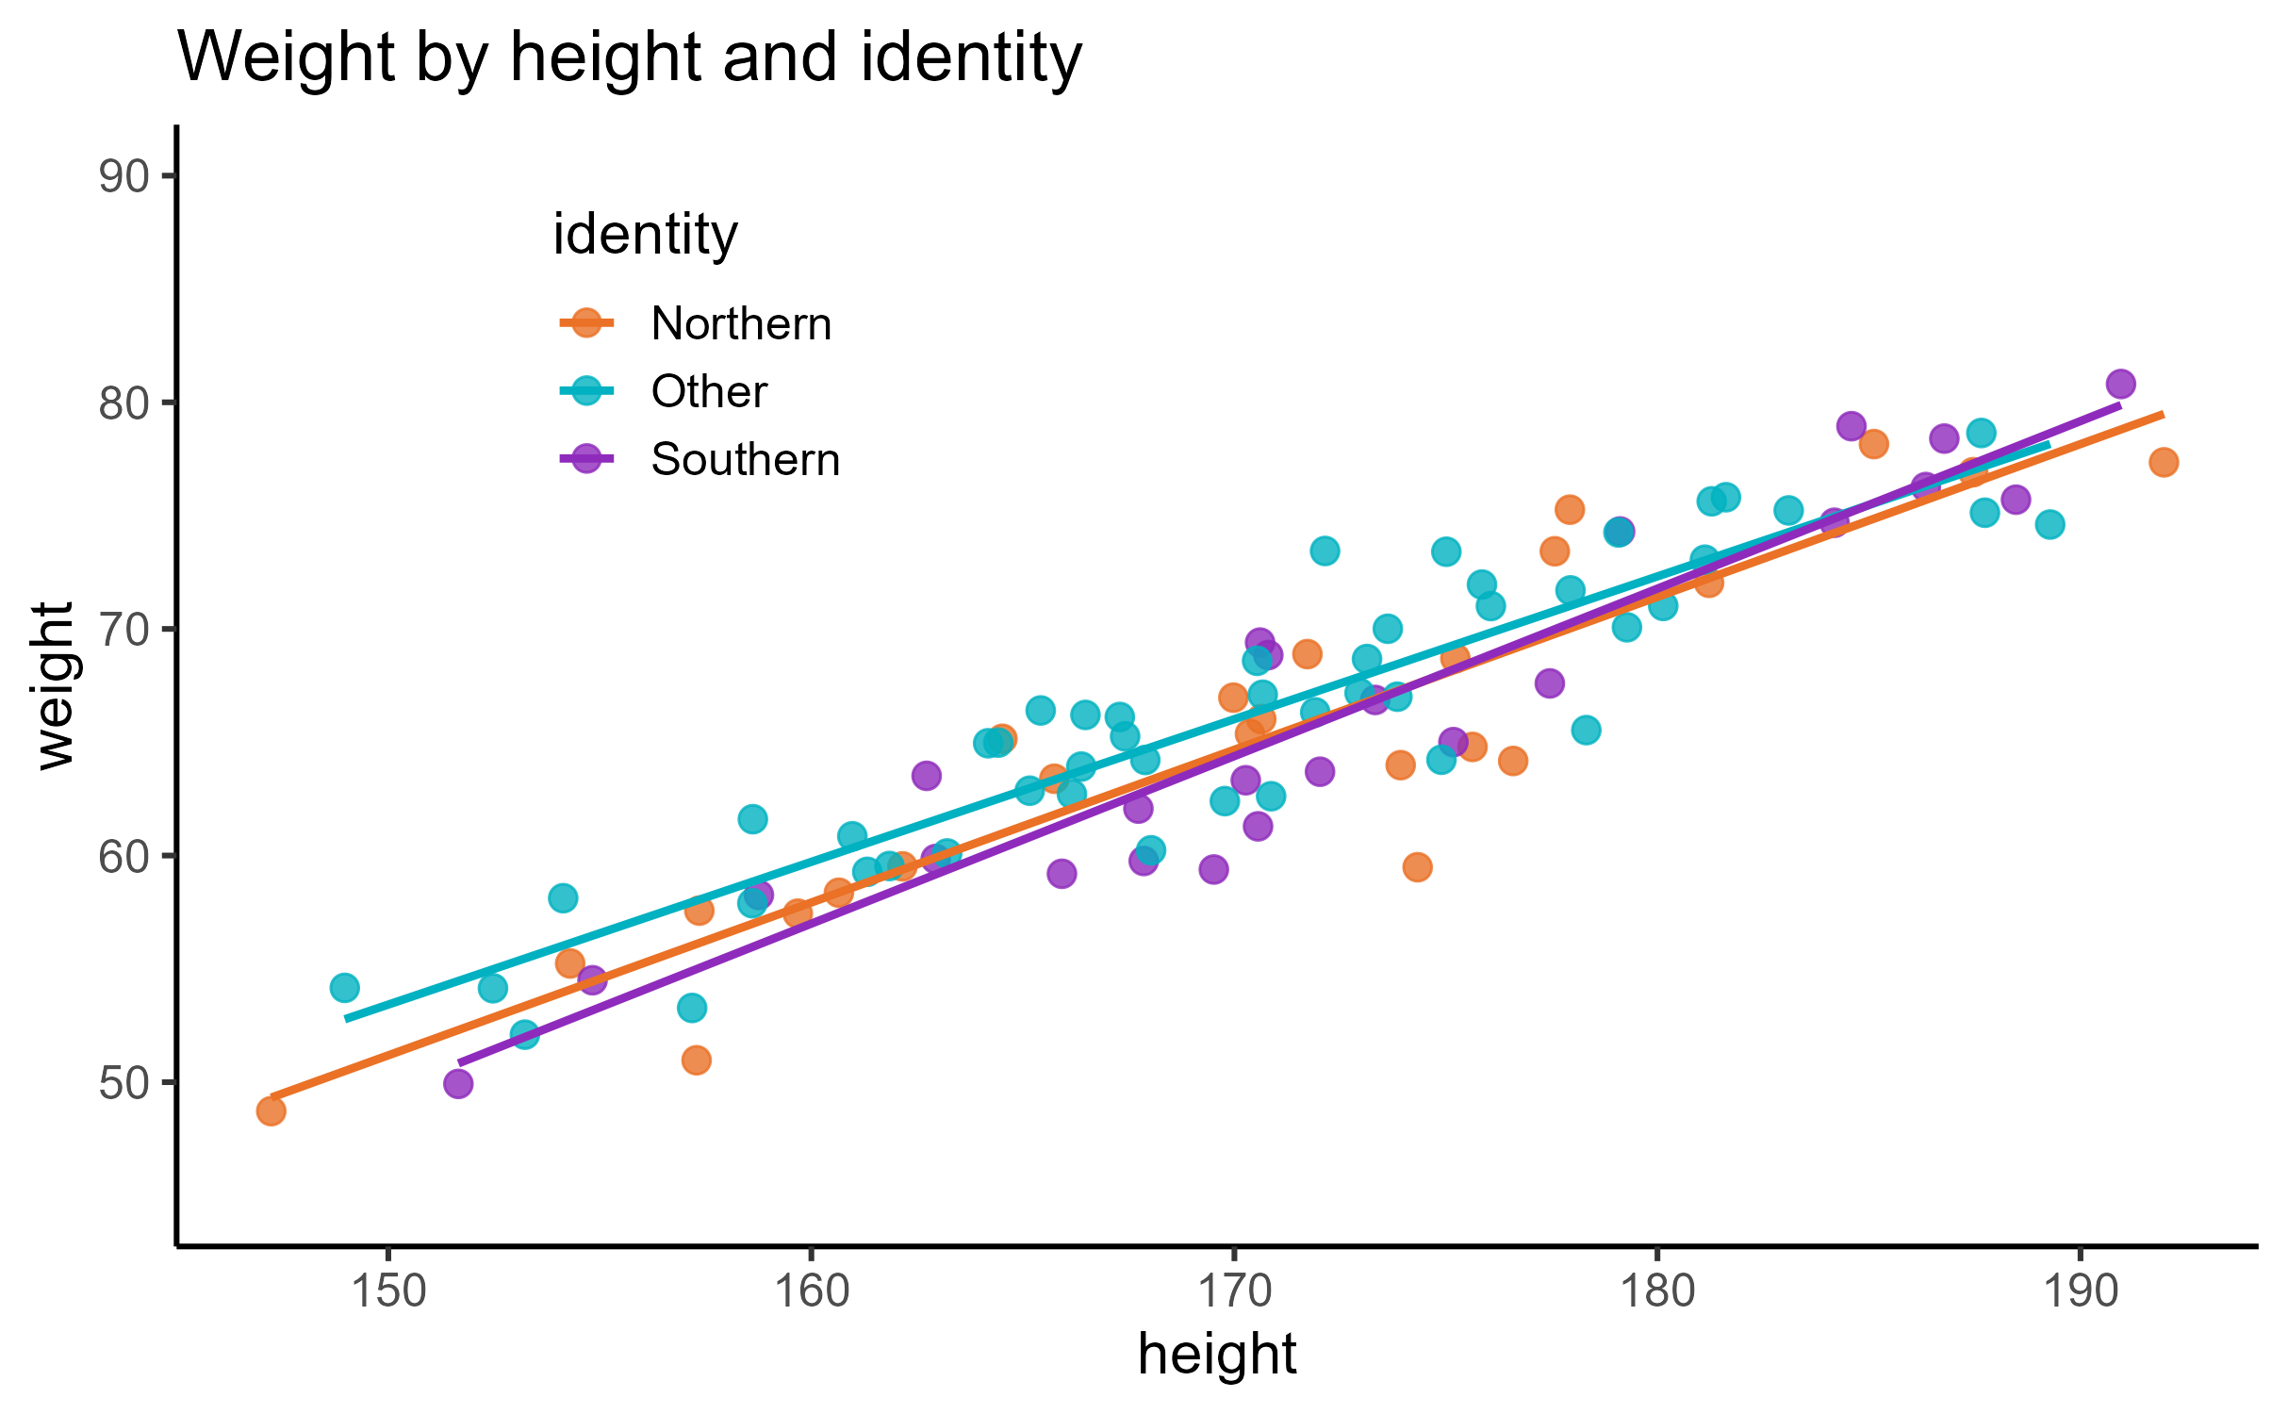
Model comparison

Slide 55
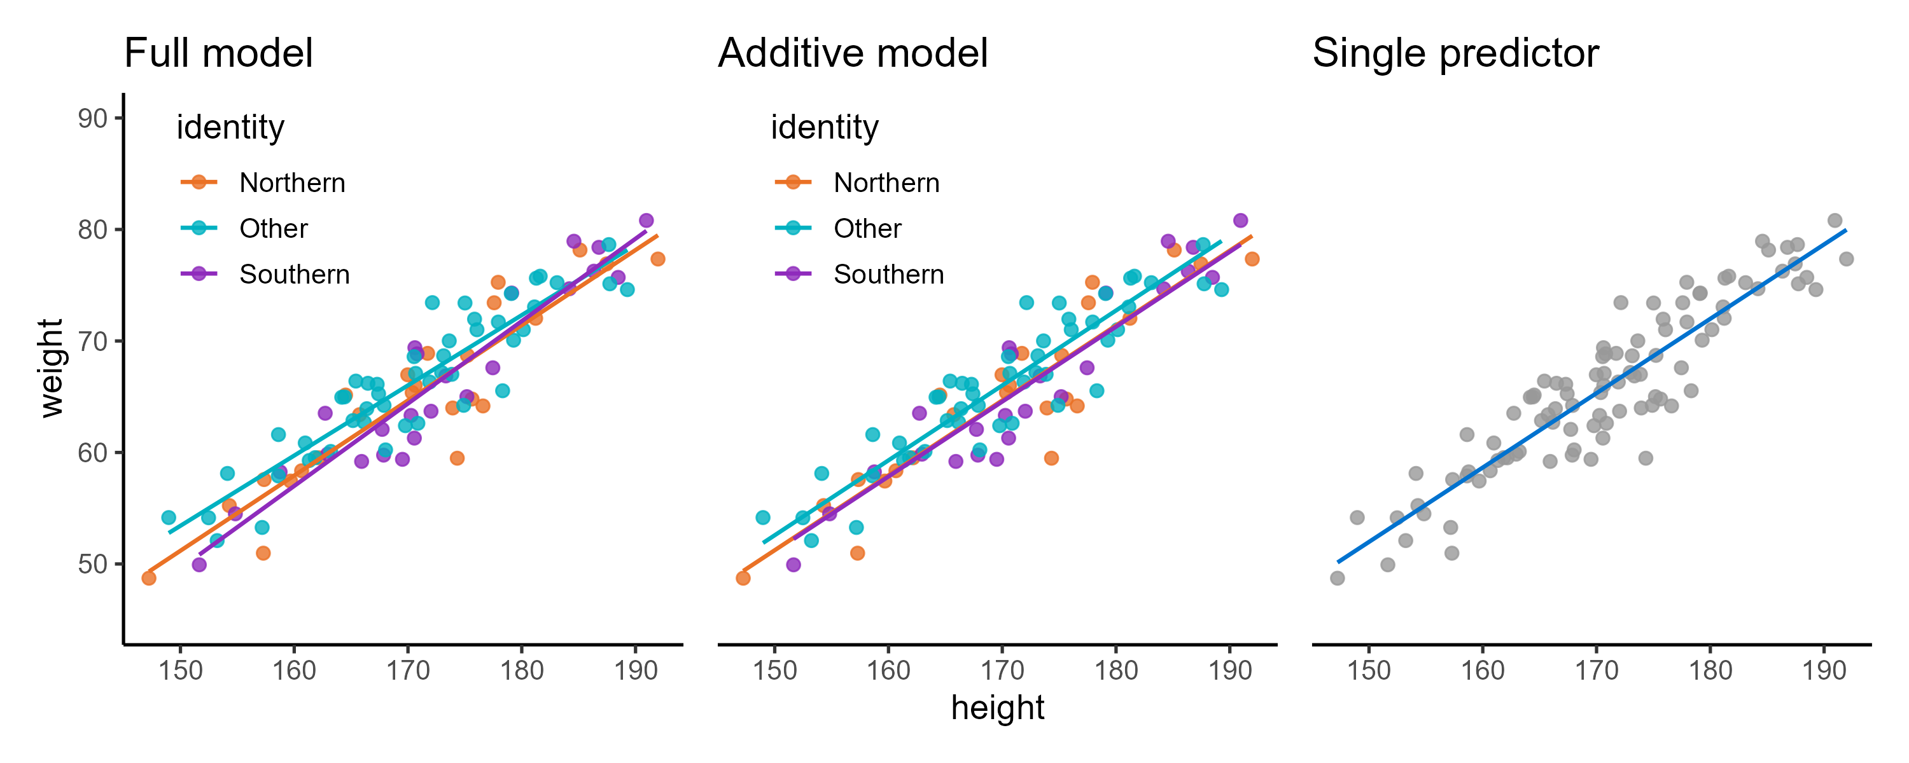
Choosing predictors
weight ~ height + identity
+ height:identity
weight ~ height + identity
weight ~ height
Notes:
Is the identity variable doing anything useful at all?

Slide 56

Model comparison
Akaike Information Criterion (AIC)
Measures trade-off between:
Goodness-of-fit (amount of error)
Complexity (number of predictors)
Used for comparing models:
Lower AIC means higher quality
Relative (within dataset) only
Looking for a difference ≥ 2
Hirotugu Akaike
Notes:
Minimising errors, getting close to your data; but also penalised for loads of predictor variables
Baked in: we want the model that has fewest terms, while explaining the data well; don’t want redundant or low-explanatory factors

Slide 57

Model comparison
Bayesian Information Criterion (BIC)
Alternative to AIC
Can be used in the same way/in addition to AIC
Also based on goodness-of-fit vs complexity
Lower BIC means higher quality
Hirotugu Akaike
Gideon Schwarz
Notes:
There’s also a Bayesian version that works very similarly

Slide 58
4. Beyond the linear model
Relaxing assumptions to increase model flexibility

Slide 59
Assumptions of a linear model
For a linear model, we are assuming:
Continuous response variable
Independent observations
Linear relationship (coefficients)
Homogeneity of variance in residuals
Normally distributed residuals
Lack of points with high leverage
Linear models are quite strict/picky

Slide 60
Assumptions of a linear model
For a linear model, we are assuming:
Continuous response variable
Independent observations
Linear relationship (coefficients)
Homogeneity of variance in residuals
Normally distributed residuals
Lack of points with high leverage

Slide 61
Alternative tests
Non-parametric tests
Do not require normally distributed residuals
Ordinal/rank data, outliers
Still assume homogeneity of variance
Welch’s test(s)
Do not require homogeneity of variance
Still assume normality

Slide 62
Parametric vs non-parametric tests
Type of analysis | Parametric test | Non-parametric test
Comparing two independent groups | Students t-test, Welch’s t-test | Mann-Whitney U test
Comparing two variables from a single sample | Paired t-test | Wilcoxon signed rank test
Comparing 3+ groups | One-way ANOVA, Welch’s ANOVA | Kruskal Wallis test
Correlation | Pearson’s r | Spearman’s rho
Testing frequency distributions | -- | Chi square

Slide 63
Branching out from simple linear models
Non-parametric regression
Generalised linear models
Generalised additive models
Non-linear modelling
Non-continuous response; link functions
No prior model form
Non-linear relationship
Structural equation modelling
Multivariate regression
Multiple response variables
Specifying structural models
Linear models
Time series analysis
Random effects
Mixed effects/
hierarchical/
multi-level models
“Tweaking” the ordinary least squares method
Partial least squares
Hazard functions
Dimensionality reduction of your predictors
Cox proportional hazard regression
(time-to-event or survival analysis)
Ridge regression, LASSO (regularisation)
Quantile regression
Robust regression
Estimates quantiles/median instead of mean
Penalties applied to “shrink” the coefficients
Weighted least squares

Slide 64
Assumptions of a linear model
For a linear model, we are assuming:
Continuous response variable
Independent observations
Linear relationship (coefficients)
Homogeneity of variance in residuals
Normally distributed residuals
Lack of points with high leverage

Slide 65
Branching out from simple linear models
Non-parametric regression
Generalised linear models
Generalised additive models
Non-linear modelling
Non-continuous response; link functions
No prior model form
Non-linear relationship
Structural equation modelling
Multivariate regression
Multiple response variables
Specifying structural models
Linear models
Linear models
Time series analysis
Random effects
Mixed effects/
hierarchical/
multi-level models
“Tweaking” the ordinary least squares method
Partial least squares
Hazard functions
Dimensionality reduction of your predictors
Cox proportional hazard regression
(time-to-event or survival analysis)
Ridge regression, LASSO (regularisation)
Quantile regression
Robust regression
Estimates quantiles/median instead of mean
Penalties applied to “shrink” the coefficients
Weighted least squares
Notes:
To give you an example of how you can bring forward your knowledge of linear models into a more complicated set of models: GLMs

Slide 66


Many life sciences variables are continuous
Binary/proportional variables
Fractional variables
Count variables

Slide 67
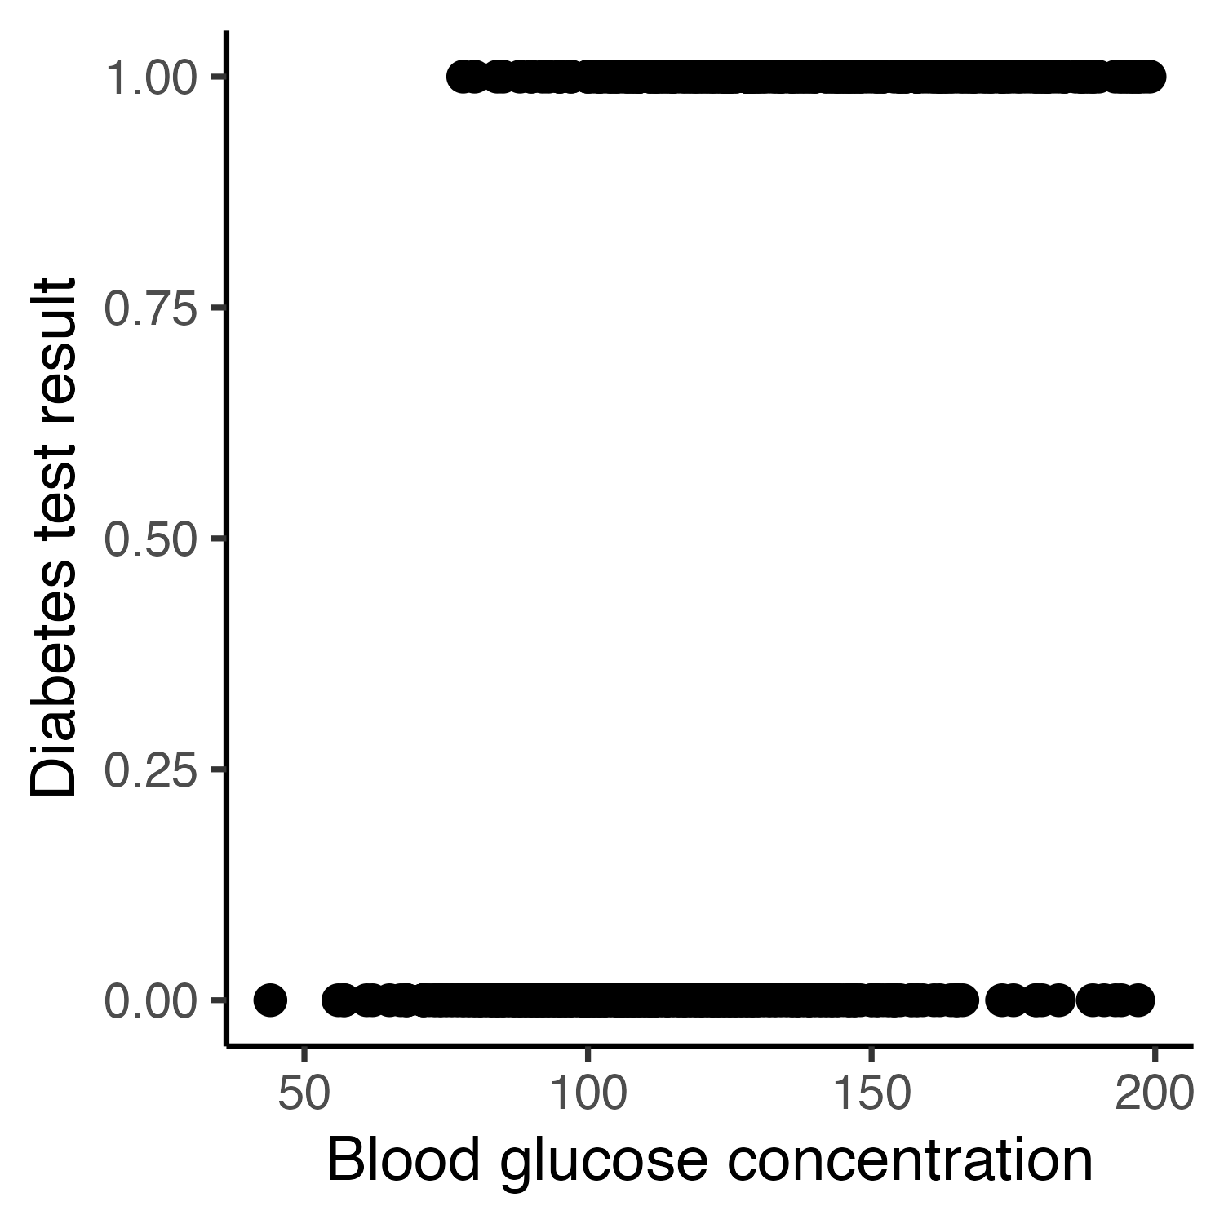
Binary example
Can the result of a glucose tolerance test predict diabetes diagnosis?
768 individuals tested for diabetes
268 with positive result
Glucose concentration after tolerance test recorded

Slide 68

Binary example

Slide 69

Binary example
Could just fit a linear model
y = -0.49 + 0.007x
p < 2.2x10⁻¹⁶
But..?

Slide 70
Binary example
But:
Predicts values outside the [0-1] range

Slide 71

Binary example
But:
Predicts values outside the [0-1] range
Assumptions of linear model are violated

Slide 72

Binary example
Use a logistic curve!

Slide 73

Binary example
Equation of a logistic curve:

Slide 74





Link function
Linear equation is embedded inside a non-linear equation
This embedding has generalised our linear model
The non-linear equation is called an inverse link function

Slide 75


What are we predicting?
Predicts values between 0 and 1
Represents the probability of “success” for a given value of x
Probability of positive diabetes test when glucose concentration is 150 ≈ 55%
Notes:
Where success = whatever you’ve coded as “1” (versus “0”) in your binary variable
Could also think of P(success) as – the proportion of times that you would expect to see someone with a blood glucose of 150, testing positive for diabetes

Slide 76
Maximum likelihood estimation
Ordinary least squares (OLS)
“Analytical” or exact solution
Aim to minimise the sum of the square of the residuals
Difference between model and actual data = residuals
Maximum likelihood estimation (MLE)
“Numerical” or approximate solution
Aim to maximise the likelihood function
Difference between model and actual data = deviance

Slide 77
Maximum likelihood estimation
Likelihood function
= joint probability of the sample, as a function of the parameters
= if the distribution had a particular set of parameters, how likely is it that we would observe these data?
Keep iterating over different sets of parameter values, until we maximise this overall joint probability

Slide 78

Maximum likelihood estimation
likelihood
parameters
This illustration was inspired by: https://www.youtube.com/watch?v=XepXtl9YKwc&ab_channel=StatQuestwithJoshStarmer

Slide 79






Maximum likelihood estimation
likelihood
This illustration was inspired by: https://www.youtube.com/watch?v=XepXtl9YKwc&ab_channel=StatQuestwithJoshStarmer

Slide 80





Maximum likelihood estimation
likelihood
This illustration was inspired by: https://www.youtube.com/watch?v=XepXtl9YKwc&ab_channel=StatQuestwithJoshStarmer

Slide 81

Maximum likelihood estimation
For a normal distribution, MLE = OLS
But MLE can be used for any type of distribution
This illustration was inspired by: https://www.youtube.com/watch?v=XepXtl9YKwc&ab_channel=StatQuestwithJoshStarmer

Slide 82
Summary
Linear models
Continuous response ~ predictor(s)
Beta coefficients/model equation fitted using ordinary least squares
Strict assumptions
Analysis of variance/F-test to measure signal-to-noise ratio
p-value to quantify probability of F-statistic (dataset) under the null
Select between candidate models for “best” fit
Generalised linear models
Non-continuous response variables e.g., binary/proportion, count
(Inverse) link function to “transform the linear model”
Relaxes some of the assumptions
Fit using computationally-intensive maximum likelihood estimation

